Slide 1


MBA - Online
SLATE LAB
One Prompt,
Many Possibilities
MBAO
Graduate Business
Reusing prompt values with exports, subqueries, and translation tables
National Online
Priority deadline
Bailey Raffield
Slate Developer, ReWorkflow
Notes:
Opening line: What if someone picked a value once, and Slate immediately understood what it means in every place you need it?
Welcome, and thanks for being here! This is a hands-on Slate Lab, so please jump in with questions and bring your own prompts into the conversation.
Rough timing for a 45 to 60 minute lab:
- 5 min: the problem and warm-up
- 10 min: prompt export values
- 10 min: translation codes
- 8 min: subquery exports
- 7 min: putting it to work
- 10 to 15 min: prove it works and design lab
- 5 min: traps, questions, close

Slide 2



ABOUT THE PRESENTER
Bailey Raffield
Custom Solutions Analyst | ReWorkflow
Custom Solutions Analyst at ReWorkflow, a Preferred Partner specializing in Slate implementation and optimization for higher education institutions. With over a decade of experience in higher ed and 5+ years of Slate admin expertise, Bailey has supported universities across the country in building and refining their Slate environments. Prior to consulting, Bailey built a foundation in IT and Slate across roles at Texas A&M University and Valdosta State University.
10+
5+
ReW
Years in higher ed
Years Slate admin
Preferred Partner
One Prompt, Many Possibilities
02
Notes:
Hi, I'm Bailey! I'm with ReWorkflow, where I build in Slate every day with our partner schools. Before consulting I was in IT and Slate roles at Texas A&M and Valdosta State.
Fun fact: I have personally built the "Program", "Program (short name)", and "Program for email" prompt lists. More than once. So this session is really me sharing the approach I wish I'd used from the start.

Slide 3
AGENDA
What we're covering today
01
Prompt export values
Five built-in options for customizing your prompts
02
Translation codes
Your reusable translation table in Slate
03
Subquery exports
Getting the right value out of the query
04
Putting it to work
Queries, exports, mailings, portals, and workflows
05
Wrap-up and reminders
Design principles, common traps, the design lab, and questions
One Prompt, Many Possibilities
03
Notes:
Here's the plan. We'll start with the problem, then the two mapping tools: prompt export values and translation codes. Then subquery exports, which is how you actually get those values out of a query. Then we'll put it all to work, and close with a hands-on section where you'll test and design around one of your own prompts.

Slide 4
THE PROBLEM
The prompt list pile-up
Before: one list per need
After: one list, many outputs
Program for queries
Program: MBA - Online
Program for SIS
MBAO
1420
Program for email copy
Graduate Business
Online
Program for deadlines
National Online
Program for territory
The problem isn't missing fields. It's the same idea stored again for every downstream need.
One Prompt, Many Possibilities
04
Notes:
Raise your hand if you have more than one prompt list for the same thing. (I'll wait.)
This is how it happens. One list for queries, one for the SIS, one because the email needed a friendlier label, one for deadlines. Now every time a program changes, you're updating it in five places and hoping you didn't miss one.
Slate isn't missing a field here. We're just storing the same concept over and over.

Slide 5
WARM-UP
How many meanings does one value have?
What should a query group by?
What should the SIS receive?
Online
MBAO
MBA - Online
▾
What should the email say?
Which deadline applies?
Master of Business Administration - Online
What should staff see?
July 13th 2026
Business Administration
One value can be human-friendly, system-friendly, and decision-friendly at the same time.
One Prompt, Many Possibilities
05
Notes:
Warm-up time. Someone picks "MBA - Online" from a dropdown. Shout it out:
- What should a query group it by?
- What does the SIS want to receive?
- What should the email actually say?
- Which deadline or workflow applies?
- What should staff see?
(Take a few answers before revealing, if you're animating the chips.)
Same selection, five different jobs. That's the whole session in one slide.

Slide 6
THE CORE MODEL
Select, convert, reuse
1
Select
2
Convert
3
Reuse
Someone (or a process) picks the original prompt value.
Export values and translation codes convert it. Subquery exports shape what the query returns.
Those values drive queries, exports, mailings, portals, and workflows.
HOW TO READ THE REST OF THE SLIDES
Prompt value
Export value
Translation value
Where it's used
One Prompt, Many Possibilities
06
Notes:
If you only remember one thing: select, convert, reuse.
The original selection stays your source of truth. Everything downstream just gets the version of it that it needs.
I'm also using the same colors on every slide from here on. Dark green is what someone picks. Light green is a prompt export value. Bright green is a translation value. Tan is where it gets used.

Slide 7

01
Prompt export values
Five built-in options for customizing your prompts.
Notes:
Section one. This is the one I use the most, and honestly the one most people already have sitting there unused on their prompts.

Slide 8
PROMPT ANATOMY
A prompt carries more than its label
Value
EDIT PROMPT · key: program
What people see on forms and in Slate.
Status
Active
Value
MBA - Online
Category
Category
Online Programs
Groups prompts in a key for forms and filters.
Short Value
Online MBA
Short Value
SIS Code
MBAO
Exports by default instead of the Value.
Dept ID
1420
School
Langdale College of Business
Export Values 1-5
Modality
Online
Named by the export labels on the key.
Display
Master of Business Administration Online
Effective / Expires
Effective / Expires
Aug 1, 2026 / (blank)
Activate / Retire a value on a schedule instead of deleting it.
Pro tip: Inactivate prompts you no longer use instead of deleting them. Your historical data will thank you.
One Prompt, Many Possibilities
08
Notes:
Here's what's actually on a prompt. Most of us only ever fill in the Value.
Category groups prompts inside the same key. Short Value exports by default instead of the Value. And then there are the export values, up to five of them. When you set up the prompt key, you give each one an export label, like SIS Code or Dept ID, and that label is what you'll see here and in your queries.
Effective and Expires let you retire a value on a schedule. And please inactivate rather than delete.

Slide 9
PROMPT EXPORT VALUES
Five lenses: which one fits?
THE FIVE LENSES ON MBA - Online
WHICH LENS WOULD YOU USE TO...
Export Value 1
"SIS Code"
MBAO
A
Match to the program in SIS
Export Value 2
"Dept ID"
1420
B
Show a department info
Export Value 3
"School"
Langdale College of Business
C
Segment a mailing by school
Export Value 4
”Modality"
Online
D
Group records in a query
Export Value 5
"Display"
Master of Business Administration Online
E
Program display name
One prompt, five stored versions. Call out a match or vote with fingers.
One Prompt, Many Possibilities
09
Notes:
Here's MBA - Online with all five export values filled in. The label in quotes is the export label I set on the prompt key, so nobody has to guess what Export Value 3 means.
Now match them up. For each scenario on the right, which lens would you use? Hold up fingers, 1 through 5.
Answers:
A. SIS: Export Value 1, MBAO
B. Clean label for staff: Export Value 5, MBA Online
C. Segment by delivery: Export Value 4, Online
D. Query grouping: Export Value 3, Graduate Business
E. Stable ID: Export Value 2, 1420
The point isn't the right answer. It's that you're now designing prompts around how they'll be used.

Slide 10
LIVE BUILD
Let's build it together
1
2
3
TRY IT
Pick one prompt you use everywhere.
What three values do you wish it already knew?
Name the export labels
Fill in the values
Pick the lens in a query
On the prompt key, give each export slot a label that says its job (SIS Code, Dept ID, School).
Add export values on each prompt. For long lists, batch it with the Prompt Import source format.
On the prompt-based export, set the Export Value setting to the export value you need. Slate translates it for you.
START Program = MBA - Online
CHANGE Export Value (SIS Code)
EXPECT MBAO
One Prompt, Many Possibilities
10
Notes:
Jumping into Slate now.
Step one: on the prompt key, set up your export labels. Name them for their job. Step two: fill in the values on each prompt. If you have a hundred programs, don't do this by hand. The Prompt Import source format lets you batch edit export values from Excel. Step three: in your query, on the prompt-based export, change Export Value to the label you want, and Slate does the translating.
Before I click Preview, here is what we should see: we start with MBA - Online, change the Export Value setting to the SIS Code export value, and the column should come back MBAO. (Double check that the setting labels on this slide match your screen.)
While I build, think about one prompt you use everywhere.

Slide 11
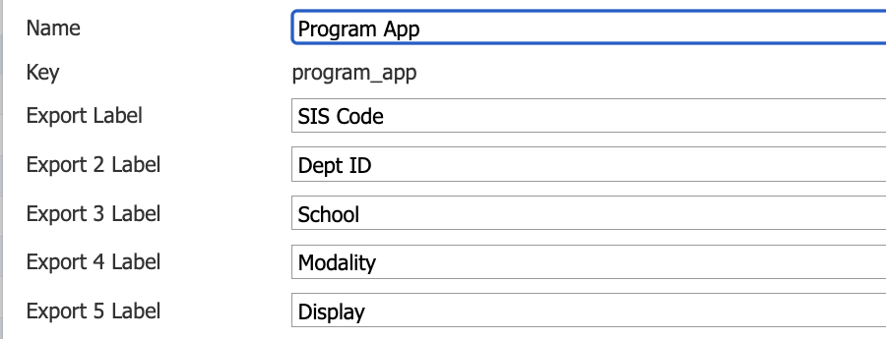
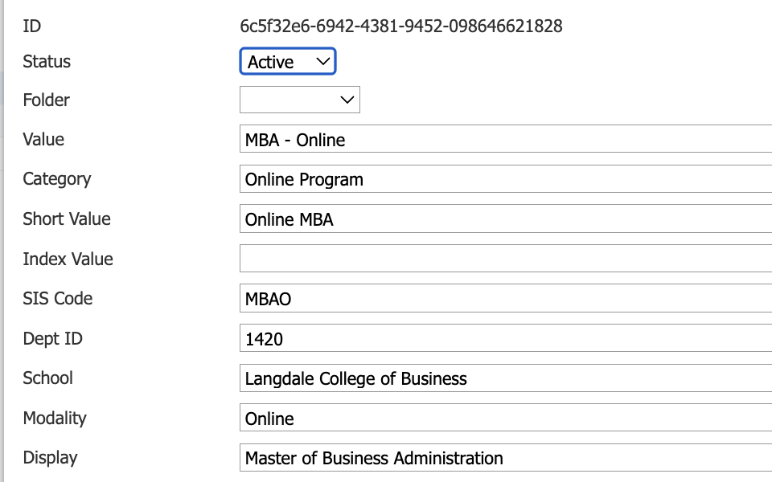
THE BUILD
Prompt exports: labels, then values
1
Name the export labels
2
Fill in the values
Prompt key: program_app
Prompt: MBA - Online
Label the slots once on the key. Every prompt in the list fills the same five slots.
START Key: program_app
CHANGE Fill five export values
EXPECT Five labeled lenses
One Prompt, Many Possibilities
11

Slide 12
BONUS BUILT-INS
Prompts already have a few more tricks
Short Value
Category: forms
Category: queries
Exports by default instead of the full Value.
Group by Category adds dropdown headers. Limit by Category shows one group on a form.
Export the Category, or filter on it to pull a whole group.
MBA - Online → Online MBA
Show only Online Programs
Online Programs
One Prompt, Many Possibilities
12
Notes:
Quick detour, two minutes max. A couple of prompt features that don't get enough love.
Short Value exports by default instead of the Value. Categories are the big one though. On forms, Group by Category puts headers in long dropdowns, and Limit by Category lets one form show just online programs without a separate field or list. In queries you can export the category or filter on it.
So before you build that second program list for a form, check if a category does the job.

Slide 13
02
Translation codes
Your reusable translation table in Slate.
Notes:
Section two: translation codes. In Slate the feature is called Translation Codes, but I think of them as a translation table, so you'll hear me use both.

Slide 14
TRANSLATION CODES
Five more meanings from the same selection
Recruitment territory
National Online
TRANSLATION KEY
program_routing
Content block key
Mba_online
MBA - Online
One code per program, each with up to five export values. Maintained in one place.
Priority Deadline
July 13th 2026
Marketing audience
business-online
Advisor Team
graduate_online_team
Export values describe the prompt. Translation codes translate the value into a usable value for various institutional needs
One Prompt, Many Possibilities
14
Notes:
Same selection, MBA - Online. Now I run it through a translation code called program_routing.
Out come five more values: the recruitment territory, a content block key for mailings, a deadline group, a marketing audience, and an advisor queue.
Here's how I think about it. Export values describe what the prompt is. Translation codes capture your business rules: what your institution does with it.

Slide 15
TRANSLATION CODE ANATOMY
How a translation code is built
Translation Key
KEY: program_routing TYPE: String
Identifier of the Translation Code
Value | Export 1 | Export 2 | Export 3
MBA - Online | National Online | mba_online | July 13th 2026
MBA - On Campus | Regional | mba_oncampus | August 10th 2026
MS Data Science - Hybrid | National Hybrid | msds_hybrid | August 10th 2026
Type
String here. Also Integer, Real Number, Date, DateTime.
Value
Strings match exactly, so spelling and spacing are important
Default Export Value: unmapped
Export Values 1-5
A program with no code falls back to the default.
Up to five outputs per code.
Pro tip: Always set a Default Export Value, so a new or missing value shows up as something you can spot.
One Prompt, Many Possibilities
15
Notes:
Quick anatomy lesson, still on our MBA - Online example. A translation code lives under a Translation Key, just like prompts live under a prompt key. This one is program_routing, and its Type is String.
With strings, the Value has to match exactly, so "MBA - Online" has to be spelled the same way the prompt is. Each code gets up to five export values.
My big pro tip: set a Default Export Value. When a new program shows up with no code, you want it to come back as "unmapped", not quietly blank.
(Numbers and dates work a little differently. They can use Min and Max ranges, and we'll look at that right after the live build.)

Slide 16
LIVE BUILD
Build program_routing, then pull it out
1
2
3
TRY IT
Setting multiple field values per record all related to a single prompt selection
That's probably a translation code waiting to happen.
Create the key
Add a code per program
Translate in the query
Add Translation Key program_routing, Type String, with a Default Export Value.
Value matches the program exactly. Fill in Export Values 1-5.
On the program export, set Export Value to the Translation Value you need, pick the key, then Preview.
START Program = MBA - Online
CHANGE Translation Value 3
EXPECT July 13th 2026
One Prompt, Many Possibilities
16
Notes:
Back into Slate, same program. I'm creating the program_routing key, adding a code for MBA - Online, and filling in the territory, content block key, and deadline group.
Then in the query, on the program export, I set the Export Value setting to the translation value I want and pick program_routing as the key. The knowledge base lists these options as Translation Value, and 2 through 5. (Double check the labels on this slide against your screen before the session.)
Before I click Preview, here's what we should see: start with MBA - Online, ask for Translation Value 3, and it should come back grad_priority_b.
One more thing: Program here is a single-value field. If your field allows more than one selection, look at the All Field Values and Single Field Value at Selected Index options, because that decides which value gets translated.

Slide 17
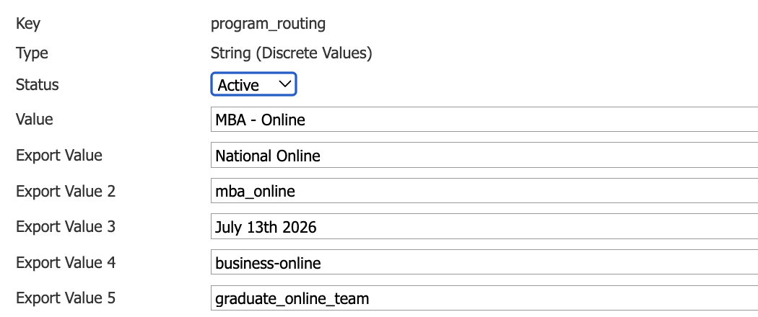
THE BUILD
Translation code: program_routing
1
Build the code row
ONE ROW, FIVE MEANINGS
Key program_routing, Type String, Value matches the prompt
Matches the prompt value exactly
Recruitment territory
Content block key
Priority deadline
Marketing audience
Advisor team
START Value = MBA - Online
CHANGE Export Value 2
EXPECT mba_online
One Prompt, Many Possibilities
17

Slide 18
TRANSLATION CODES
Beyond text: number and date ranges
Numeric and date types
KEY: gpa_band TYPE: Real Number
Integer, Real Number, Date, and DateTime can use ranges.
Min | Max | Export 1 | Export 2 | Export 3
3.50 | 4.00 | A | Honors review | Merit
3.00 | 3.49 | B | Standard review | Merit
2.50 | 2.99 | C | Committee | None
Min / Max
Inclusive on both ends, so watch the gaps between bands.
Good for
GPA bands, test concordance, and dates to seasons.
Default Export Value: Review
Anything outside every range falls back to the default.
One Prompt, Many Possibilities
18
Notes:
Translation codes aren't just for text values like our program names. With numeric and date types you can use Min and Max ranges, like these GPA bands. Instead of matching one exact value, a code covers everything between its Min and Max. Min and Max are inclusive, so be careful not to leave gaps like 3.495 between bands.

Slide 19
REAL-WORLD EXAMPLES
Where translation codes earn their keep
Application deadlines
GPA bands
Major to college
Term + program + degree + enrollment type in, deadline date and label out.
A GPA range in, an institutional rating or reviewer band out.
Roll dozens of majors up to a college for queries and messaging.
Country codes
Subject lines
Dates to seasons
Country in, ISO-2, ISO-3, or a vendor's custom code out.
Audience in, subject line or campaign label out. No duplicate mailings.
A date range in, a season or recruitment period out.
One Prompt, Many Possibilities
19
Notes:
Some of the places translation codes do the most work.
Deadlines is the big one. If your deadlines depend on term plus program plus degree plus enrollment type, a translation code is so much easier to maintain than rules or hard-coded dates.
Subject lines are a sleeper hit. Content blocks don't belong in subject lines, but a translation code does.

Slide 20
CHOOSE YOUR TOOL
Export value or translation code?
Use a prompt export value when...
Use a translation code when...
The alternate meaning belongs to that prompt
The result is a related business rule or classification
You need a stable ID, short code, label, or grouping
You're mapping a value to an operational outcome
It should travel with the prompt everywhere
The same value needs different outcomes by context
It's a simple one-to-one representation
You need ranges or a combination of inputs
One Prompt, Many Possibilities
20
Notes:
The question I get most: which one should I use?
If the value is just a fact about that prompt option, like the program's code, it's an export value. If it's a business rule, depends on context, or needs a range or more than one input, it's a translation code.
Export values tell us what the prompt is. Translation codes decide what Slate should do with it. And most of the time, the real answer is both.

Slide 21
03
Subquery exports
Getting the right value out of the query.
Notes:
Section three. We've built the mappings. Now let's talk about how the query actually delivers the result, because the mapping is not the output.

Slide 22
SUBQUERY EXPORTS
When the mapping is not the output
STORES
MAPS
DELIVERS
Prompt export values
Translation codes
Subquery export
Store alternate versions of the selected prompt.
Map an input to the outputs you configured.
Retrieve and shape the result for the query.
MBAO
July 13th 2026
One clean column per record
A subquery isn’t just five more values. Its Output controls how the query returns the data.
One Prompt, Many Possibilities
22
Notes:
Here's the distinction I want everyone to leave with. Prompt export values store alternate versions of the prompt. Translation codes map an input to outputs you configured. Neither of those is the output yet.
The subquery export is the piece that retrieves and shapes the result for the query you're running. It's not another set of five values. Its Output setting, things like Rank, Coalesce, and Concatenate, controls how the query returns the data.
KB references: Subquery Exports & Outputs, and Query Part Export Settings.

Slide 23
SUBQUERY EXPORTS
Follow one value through the query
1. Field Value
2. Export setting
3. Query result
FIELD
Export: SIS Code
Name | SIS Code | Priority Deadline
Jordan | MBAO | July 13th 2026
Program (prompt-based, single value)
Export Value: Export Value (SIS Code)
STORED VALUE
MBA - Online
Export: Deadline Group
Export Value: Translation Value 3 · Key: program_routing
Same stored value, a different column out of each export.
START MBA - Online
CHANGE Two export settings
EXPECT MBAO + July 13th 2026
One Prompt, Many Possibilities
23
Notes:
Let's follow MBA - Online all the way through.
Step one, the source: Program is a prompt-based, single-value field, and the stored value is MBA - Online.
Step two, the export settings. I have two exports on the same field. One uses the SIS Code export value. The other uses Translation Value 3 from program_routing.
Step three, the result: one row for Jordan, with MBAO in one column and grad_priority_b in the other.
(Before the session: swap these mockups for screenshots of your tested configuration, and label the exact input and output at each stage. If your config nests a subquery, show the inner and outer parts separately.)

Slide 24
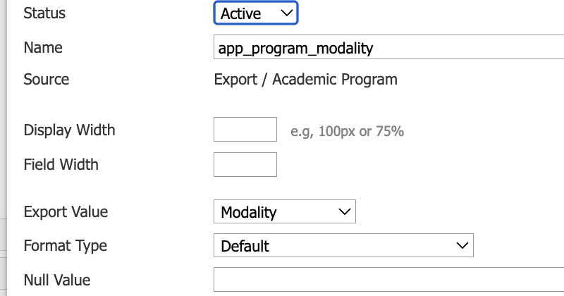
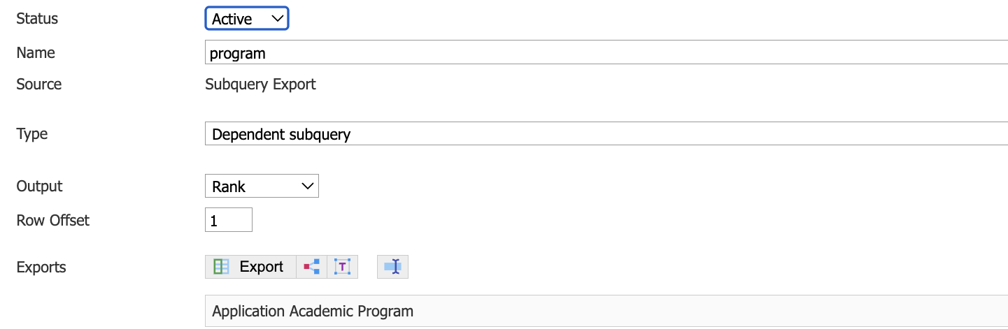
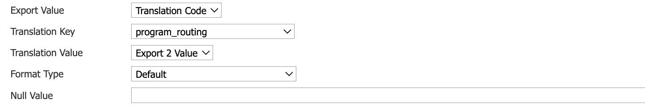
THE BUILD
Query export and subquery export
1
Query export: custom label
2
Subquery export: translation
Export Value = Modality, a label from the prompt key
Rank output, then Translation Code
START MBA - Online
CHANGE Modality + Export 2
EXPECT Online + mba_online
One Prompt, Many Possibilities
24

Slide 25
SUBQUERY EXPORTS
Three subquery outputs worth knowing
Rank
Coalesce
Concatenate
Pick one entry when a record has several.
Return the first export that isn't blank.
Combine exports and literal text in one output.
Most recent application's program
Display label, else the Value
Display + " (" + School + ")"
MBA - Online
MBA Online
MBA Online (Graduate Business)
ASK THE ROOM
Someone has three applications and you need one program per row. Which output would you use?
One Prompt, Many Possibilities
25
Notes:
There are a lot of subquery outputs. I'm only going to demo the one or two that fit our example, and the rest are here for reference.
Rank picks one entry when there are several, like the program on someone's most recent application. Coalesce returns the first export that isn't blank, so you can fall back to the Value when the display label is empty. Concatenate combines exports and literal text into one output.
Ask the room: someone has three applications and you need one program per row. Answer: Rank.
The rest (Aggregate, Dictionary, Existence, and more) are in the Subquery Exports & Outputs article.

Slide 26
04
Putting it to work
One selection, many Slate experiences.
Notes:
Section four. Now that we've got the values, let's see where they actually earn their keep.

Slide 27
WHERE IT GOES
One selection, many Slate experiences
Queries
Export Value 3
Mailings
Translation Value 2
Graduate Business
online-mba content block
Data exports
Export Value 1
MBA - Online
Form
Translation Value 3
MBAO
July 13th 2026
Portals
Category
Staff routing
Translation Value 5
Online Programs
graduate_online_team
Five export value slots. Up to five outputs per translation code. Build only what your process needs.
One Prompt, Many Possibilities
27
Notes:
Here's the finished journey for the same program we've been following all session, MBA - Online.
Queries group it as Graduate Business. The SIS gets MBAO. The portal groups it under Online Programs using the category. Mailings pull the online-mba content block. Workflow lands it in the grad_priority_b deadline group. And staff routing sends it to the graduate online team.
Not one extra prompt list in that whole journey. Five export value slots, up to five outputs per translation code, and you only build what your process actually needs.

Slide 28
PUTTING IT TO WORK
Queries and exports
QUERY / EXPORT MOCKUP
ASK THE ROOM
Prompt filter
Program = MBA - Online
The selection
Which values belong in the query logic, and which belong in the output?
Exports
School = Graduate Business
Export Value 3
Exports
SIS Code = MBAO
Export Value 1
Translation output
Priority Deadline = July 13th 2026
Translation Value 3
grad_priority_b is a group code, not a date. The actual deadline date comes from its own mapping.
One Prompt, Many Possibilities
28
Notes:
Here's that inside a query or export. The prompt is the filter. Export Value 3 drives row logic. Export Value 1 is a column in the file. The translation code gives me a deadline group. Quick but important: grad_priority_b is a group code, not a date. If you need the actual date, that comes from its own mapping, like a deadline translation code.
Question for the room: which of these belong in the logic, and which only belong in the output? That distinction matters a lot when you troubleshoot later.

Slide 29
PUTTING IT TO WORK
Mailings and content blocks
Query export name | Example result | Used in
program_display | MBA Online | Message body
program_school | Graduate Business | Message body
program_content | online-mba | Content block selection
MESSAGE PREVIEW
Subject: Your online MBA timeline is here
Hi Jordan,
Thanks for your interest in the MBA Online program with Graduate Business.
BEHIND THE SCENES
{{program_display}}
{{program_school}}
{{program_content | block: "program"}}
Content block "online-mba": flexible schedule, virtual info sessions, and online student stories
Pro tip: Anything a content block uses must be an export first. And content blocks never go in subject lines.
One Prompt, Many Possibilities
29
Notes:
Now the fun part, at least for me, because I love Liquid.
The table on the left is the key lesson: the mapping produces a value, and the query export makes it available. The mailing still has to be set up to use it. program_display and program_school go straight into the message body. program_content picks the content block, using the block filter: export name, pipe, block, and the content block key.
The subject line comes from a translation code, because content blocks don't go in subject lines, CC, or recipient fields. And anything your block uses as a merge field or condition has to be configured as an export first.
(For the live session, use a tested mailing and matching query so this isn't just an illustration.)

Slide 30
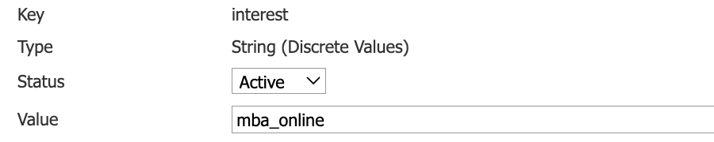
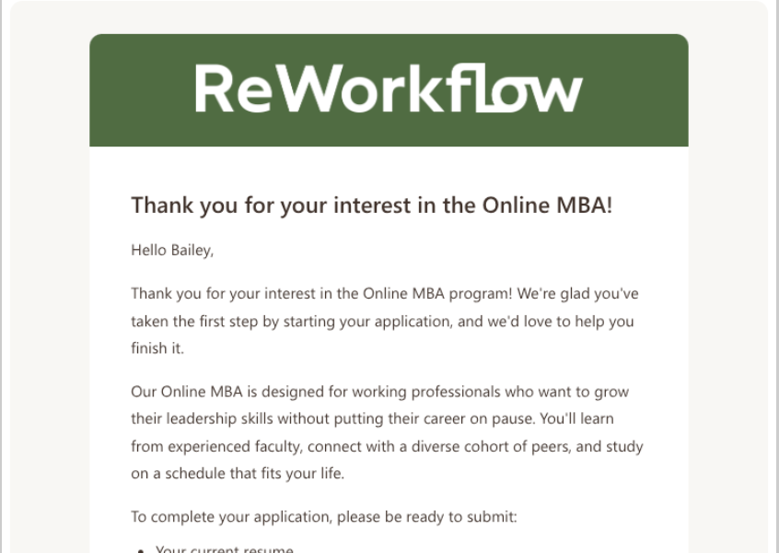
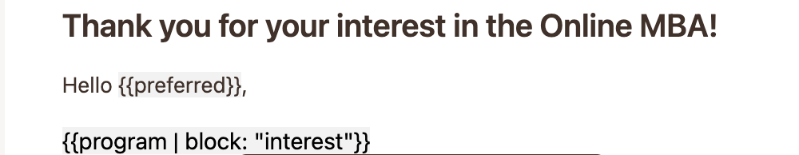
THE BUILD
Content block: from code to email
1
Create the content block
3
Preview the result
Key interest, Value mba_online
The block resolves to the Online MBA content
2
Call it from the message
{{program | block: "interest"}}
One Prompt, Many Possibilities
30

Slide 31
05
Wrap-up and reminders
Design principles, common traps, the design lab, and questions.
Notes:
Last section, and the best part. Let's get your prompts into the conversation.

Slide 32
DESIGN PRINCIPLES
Build it for reuse
1
Start with a human-readable value
Make the selection clear to the person choosing it.
2
Give every export value a named job
Export labels like "SIS Code" beat a mystery Export Value 4.
3
Use stable codes for integrations
Never make downstream logic depend on a label that might change.
4
Store frequently changing info in translations
Separate what stays the same from what changes every cycle.
5
Document ownership and lifecycle
Who updates values, codes, and effective dates, and when.
One Prompt, Many Possibilities
32
Notes:
These are the rules I actually follow.
The export label one is my soapbox. Future you, or whoever inherits your instance, will not remember what Export Value 4 means. Name it.
And decide who owns this stuff. Somebody needs to be responsible for updating values, codes, and effective dates, or it drifts.

Slide 33
COMMON TRAPS
Keep the superpower useful
AVOID
DO THIS INSTEAD
✕
Using display values as integration codes
✓
Send a stable export value
✕
A new prompt list for every audience or query
✓
Reuse one selection with converted outputs
✕
Business logic hidden in labels
✓
Make the conversion explicit and named
✕
Changing shared translations without a plan
✓
Check owners and downstream impact first
✕
Solving everything with one tool
✓
Export values for what it is, translations for rules
One Prompt, Many Possibilities
33
Notes:
A few traps I see all the time.
The first one bites people the most: sending a display label to an integration. Someone renames the program to make it prettier, and suddenly your SIS import breaks. Use a stable export value.
And before changing a shared translation code, check who else is using it. It's shared for a reason.

Slide 34
DESIGN LAB
Turn your prompt into a power tool
Original prompt value | Who selects it? | Export value ideas | Translation value ideas | Where is each used?
1
2
3
4
Pick one prompt list your school uses widely
Find one duplicate list or manual lookup it could replace
Define one data use and one personalization use
Decide: export value, translation code, or both
Snap a photo of this slide and fill it in with your table.
One Prompt, Many Possibilities
34
Notes:
Your turn. Grab a photo of this slide, or just talk it through with the people at your table.
Pick one prompt your school uses everywhere. Find one duplicate list or manual lookup it could replace. Come up with one data use and one personalization use. Then decide if each one is an export value, a translation code, or both.
Give it about ten minutes, then I want to hear a few and we'll build one live.

Slide 35
Design the prompt once.
Convert it intentionally.
Reuse it everywhere it adds value.
What's one prompt in your database that's doing less work than it could?
Notes:
So here's where I want to leave you: design the prompt once, convert it intentionally, and reuse it everywhere it adds value.
And one question to take home: what's one prompt in your database that's doing less work than it could?

Slide 36

Questions? Let's talk!
USEFUL KNOWLEDGE BASE RESOURCES
Bailey Raffield
Prompts
knowledge.technolutions.net/docs/prompts
knowledge.technolutions.net/docs/prompts-settings
knowledge.technolutions.net/docs/prompt-categories
knowledge.technolutions.net/docs/batch-create-edit-prompts-prompt-import-source-format
Translation codes
knowledge.technolutions.net/docs/translation-codes
Content blocks
knowledge.technolutions.net/docs/content-blocks
knowledge.technolutions.net/docs/dynamic-content-blocks
Queries
knowledge.technolutions.net/docs/subquery-exports-outputs
knowledge.technolutions.net/docs/query-part-export-settings
Custom Solutions Analyst
ReWorkflow
braffield@reworkflow.com
Notes:
Thank you all so much! Here are the knowledge base articles I leaned on for this session, so you can pick up where we left off.
I'd love to keep talking through your use cases, so grab me after or send me an email.

