Slide 1


2026 Slate Summit Features
Max Zeryck
Senior Slate Developer
Texas User Group, October 2026

Slide 2


Two Primary Themes
      Quality of Life
      AI

Slide 3
Two Primary Themes
      Quality of Life updates make incremental progress in some commonly used parts of Slate
      AI lets you use natural language to automate manual processes and analyze data

Slide 4
Quality of Life

Slide 5
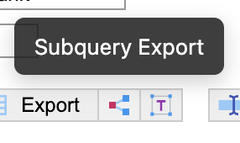

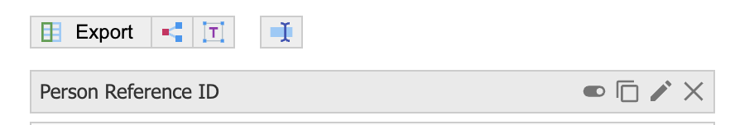
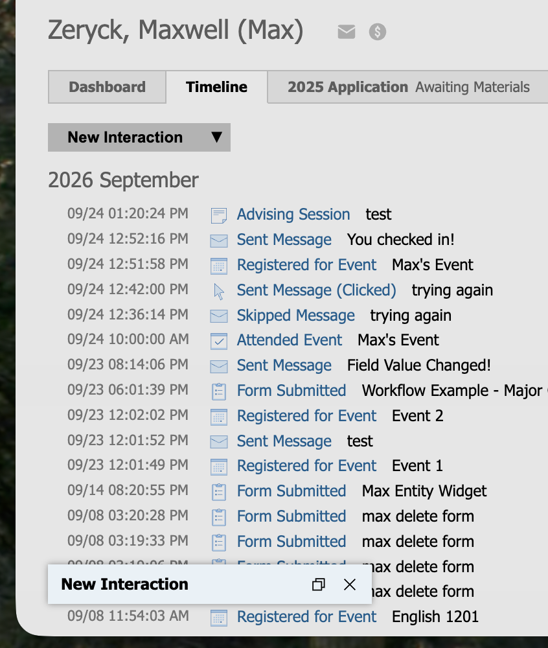
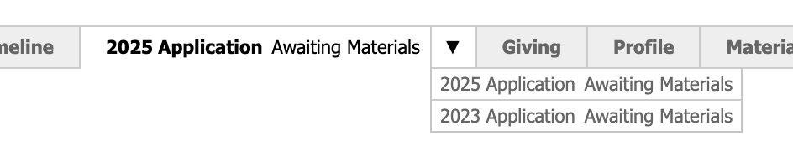
UI Tweaks
Enhanced tooltips
Editing exports in express mode
App tab compression (Early Access)
Modal minimizing/maximizing

Slide 6
Communication Triggers
      Reader Form Communications
        No longer requires a separate Deliver mailing
        Sends immediately and fewer objects to manage
      Event Check-In Emails
        Sends immediately upon check-in
        Great for venue info (WiFi, food, restrooms, etc.)

Slide 7
Portals and Tabs
      Express portals on the homepage
      Custom tab express portals
      Subtabs
      Widget tabs

Slide 8
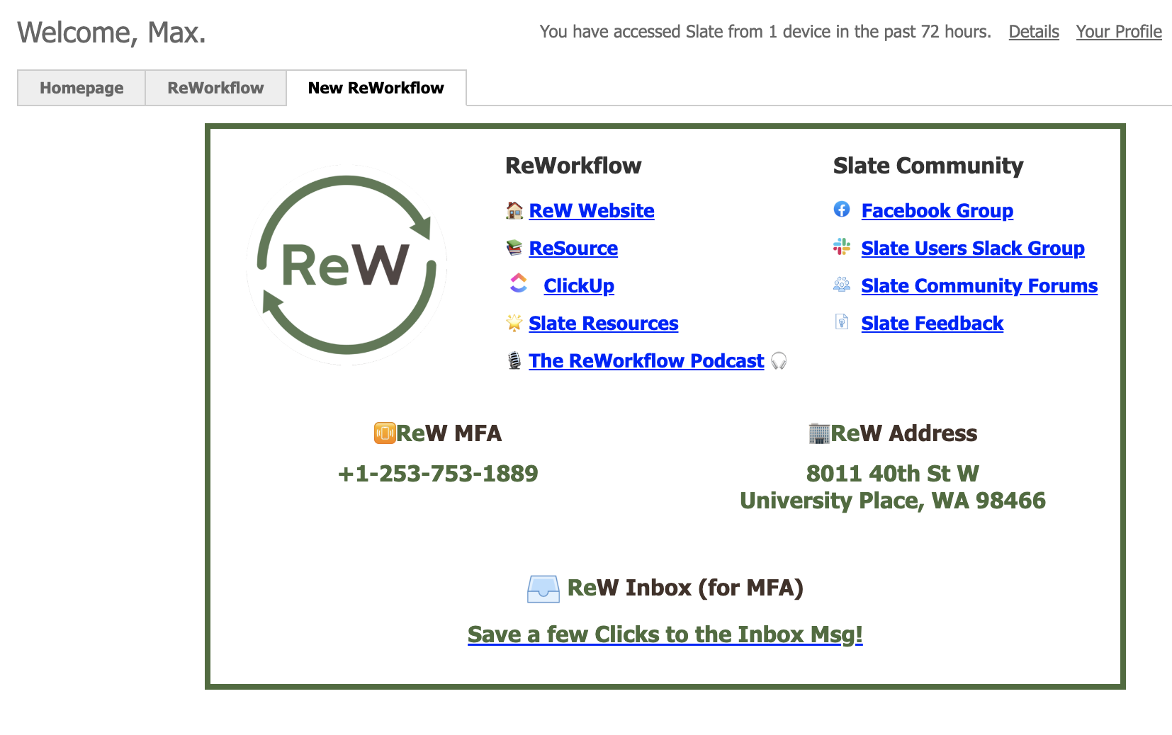
Portals and Tabs
      Express portals on the homepage
        No longer need a dummy report for static content

Slide 9
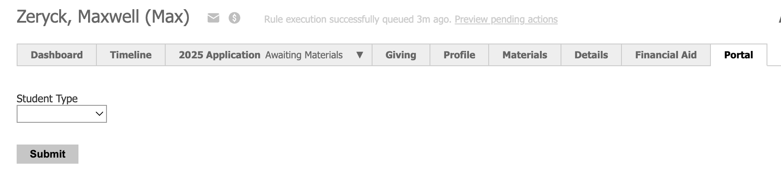
Portals and Tabs
      Custom tab express portals
        Display form without clicking the edit icon

Slide 10
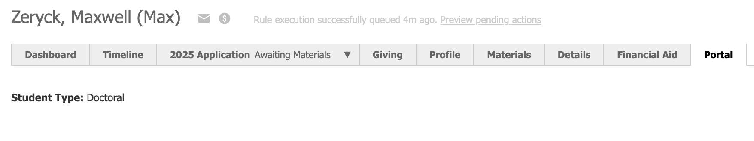
Portals and Tabs
      Custom tab express portals
        Change display based on submission

Slide 11
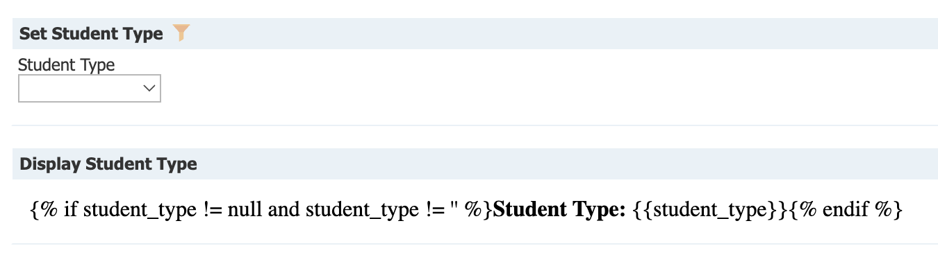
Portals and Tabs
      Custom tab express portals
        Determine if Person-scoped form needs to be Unsafe

Slide 12
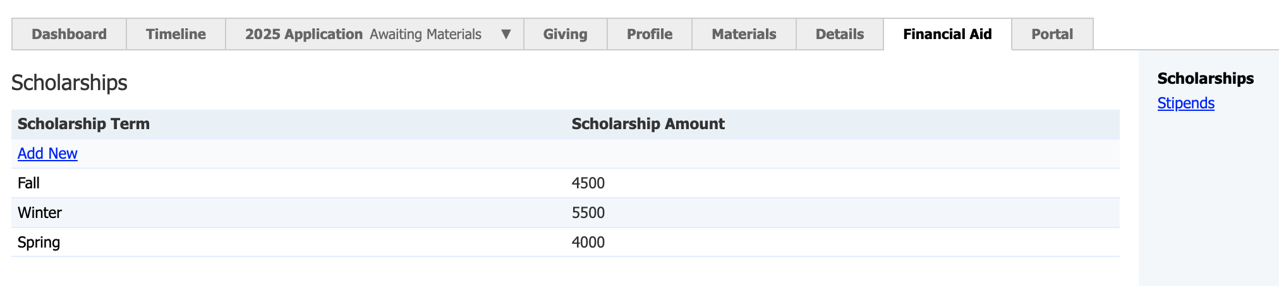
Portals and Tabs
      Subtabs
        Organize big custom tabs into smaller pieces, like app tabs
        More granular conditional permissioning

Slide 13
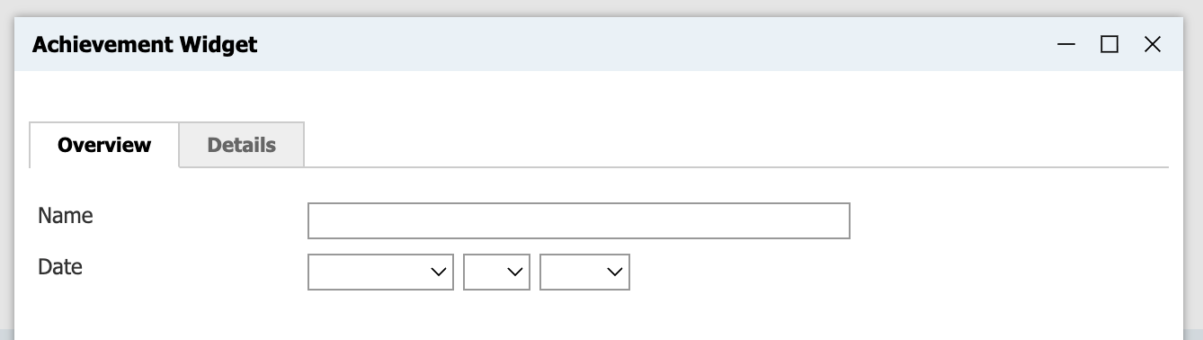
Portals and Tabs
      Widget tabs
        Organize big widgets into smaller pieces

Slide 14
Other Features
      Record a custom voicemail message for Slate Voice
      Custom printed badge sizes for events
      Preferred Partner Login

Slide 15
Soon & Future

Slide 16
Coming Soon
      These features are available to see but not ready to use:
      Form response workflows
      System tab write permissions
      Entity materials
      Time zone settings

Slide 17
Future Features
      These features were announced at Summit but aren’t out yet:
      Integrated configuration tools
      Query library inheritance
      Joinable bridge
      Legacy workflow migration
      External access (exports, web services, portals, etc)
      Slate.org contact sync
      Campaigns reboot
      Custom delivery windows
      Searcher ("abacus") widgets in portals
      AI Content Blocks
      AI Campaigns
      AI query knowledge, chat bot query knowledge, data studio
      AI Slate Co-captain

Slide 18
Future Features
      These features were announced at Summit but aren’t out yet:
      Integrated configuration tools
      Query library inheritance
      Joinable bridge
      Legacy workflow migration
      External access (exports, web services, portals, etc)
      Slate.org contact sync
      Campaigns reboot
      Custom delivery windows
      Searcher ("abacus") widgets in portals
      AI Content Blocks
      AI Campaigns
      AI query knowledge, chat bot query knowledge, data studio
      AI Slate Co-captain

Slide 19
AI

Slide 20
Types of AI Features
      Best Uses of AI:
      Streamlining Processes: let the AI do repetetive tasks
      Administrative Interactivity: let Slate users talk to AI about the work they’re doing
      Use Caution:
      Constituent Interactivity: letting your constituents talk to AI
Notes:
Talk about Inbox AI Snippets vs using Slate AI to write snippets

Slide 21
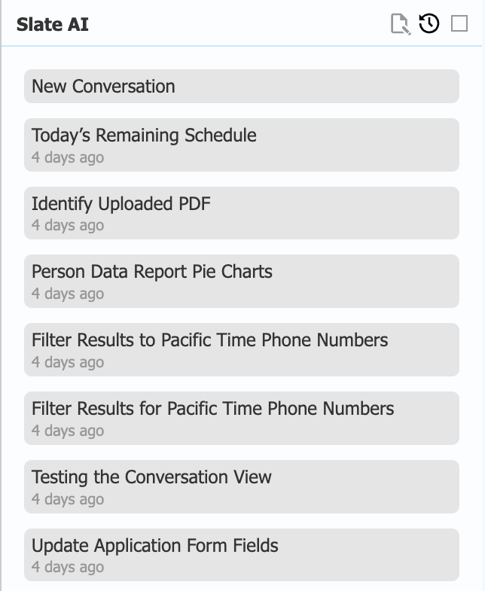
AI Quality of Life
      Slate AI also got quality of life features:
      Maximize the Slate AI view
      Use Slate AI on mobile
      Dictate to AI (speech to text)
      View a history of past conversations
      Ask about your calendar events

Slide 22
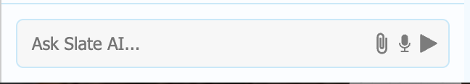
AI Images and Files
      You can now upload images and files to Slate AI
      Works just like similar AI tools
      Watch out: they disappear after upload

Slide 23
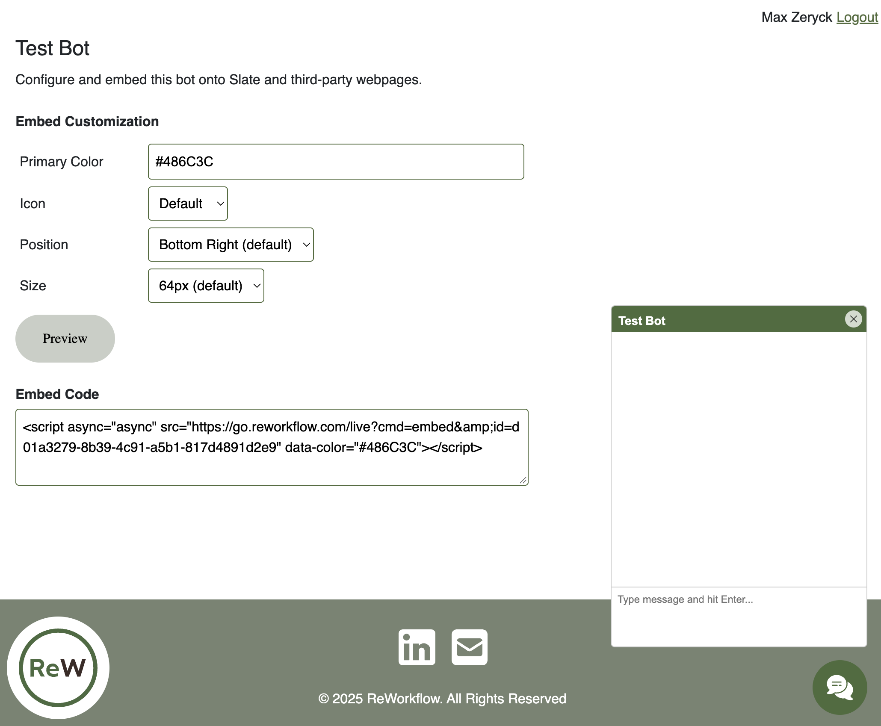
AI Chat Bot Improvements
      Customize the chat bot embed

Slide 24
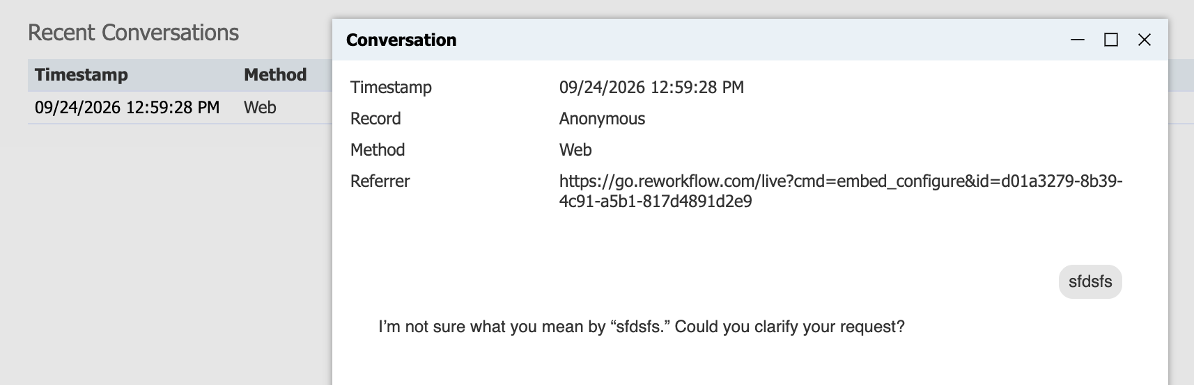
AI Chat Bot Improvements
      View past conversations

Slide 25

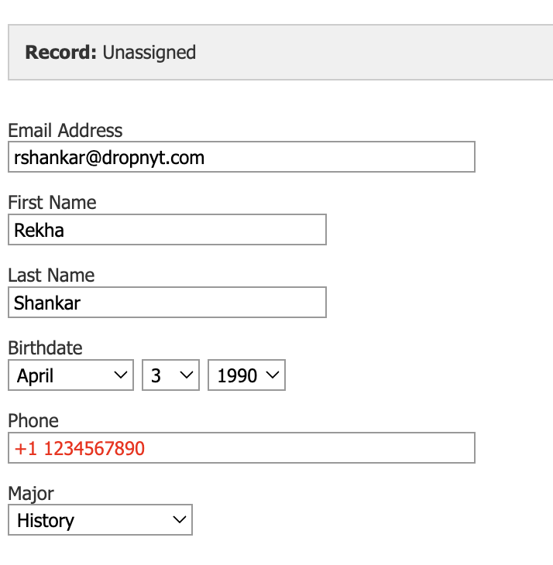
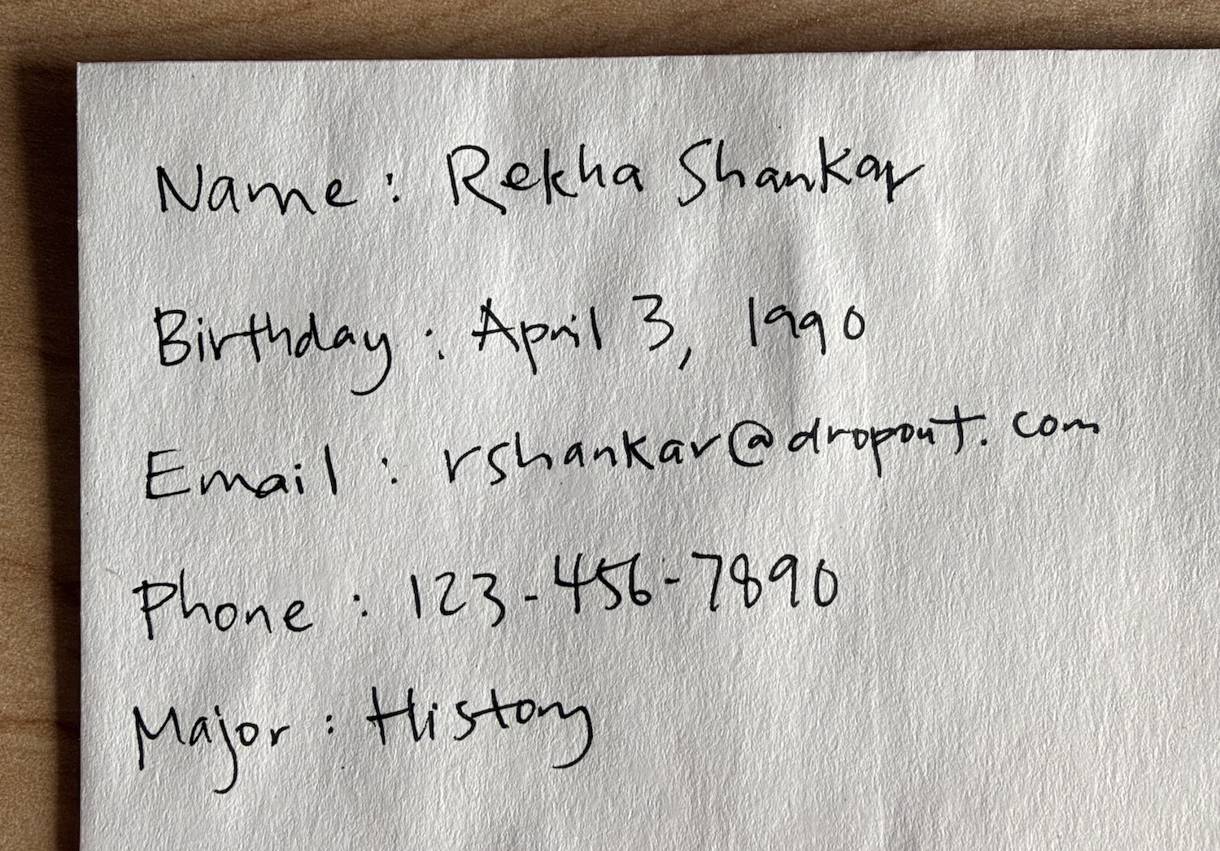
AI Form Scanner
      Works with any image, including handwriting

Slide 26
AI 💚 Data
      Dynamic Queries
      AI Data Explorer

Slide 27
Dynamic Queries
      Have you ever wished you could talk to your query results?
      Query for a broad population, add relevant exports, and use natural language to filter further

Slide 28
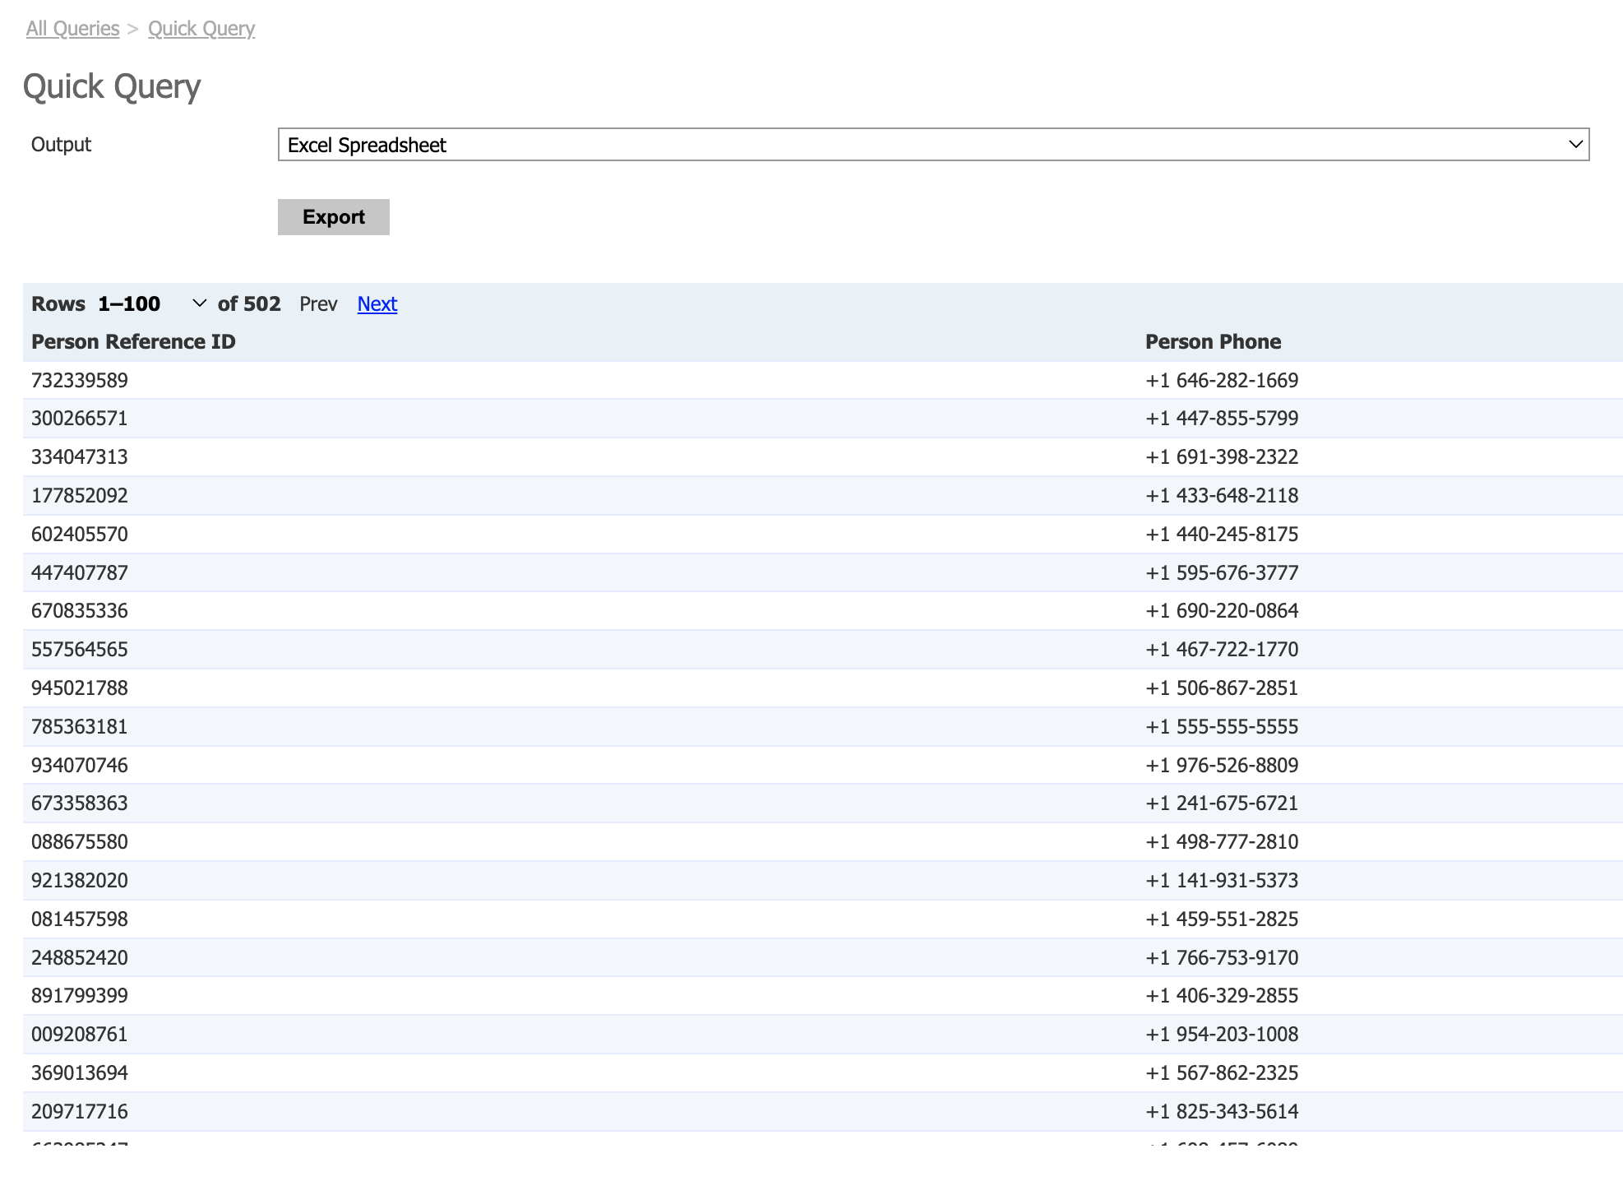
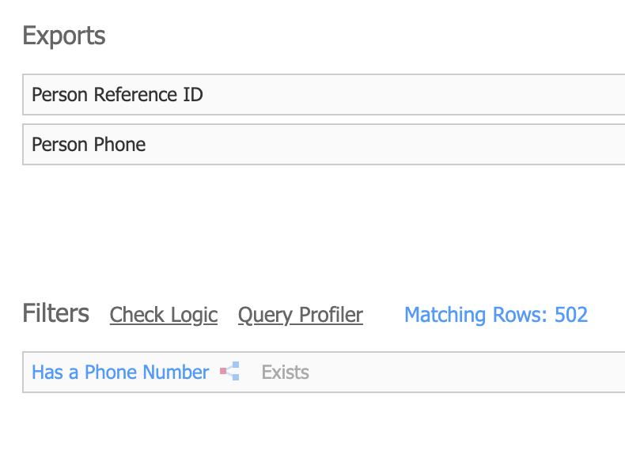
Dynamic Queries

Slide 29
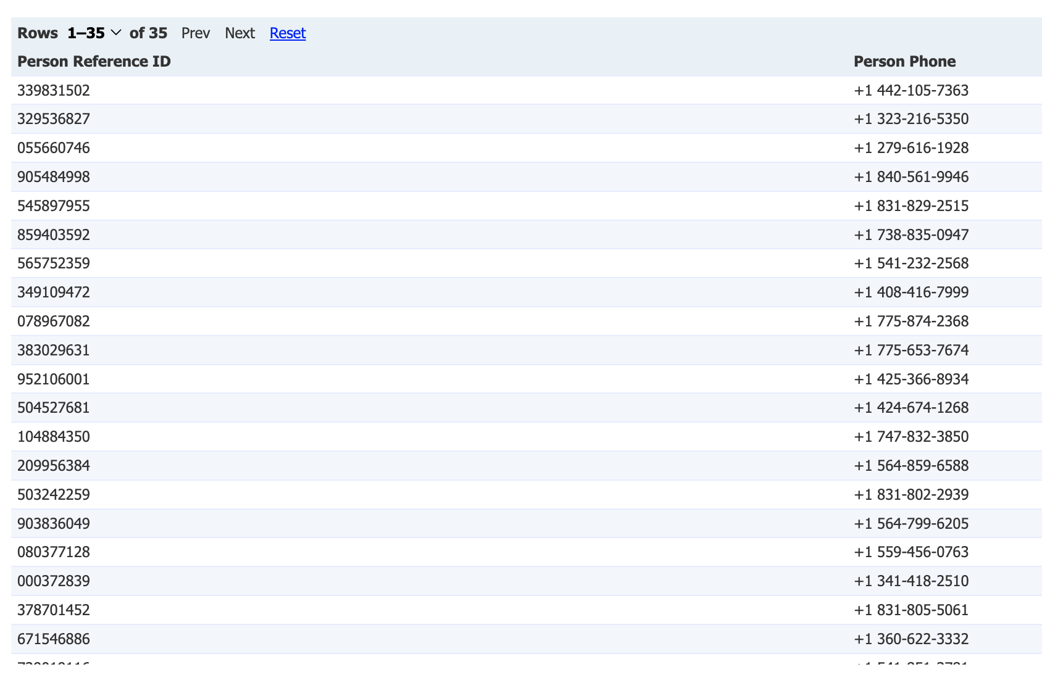
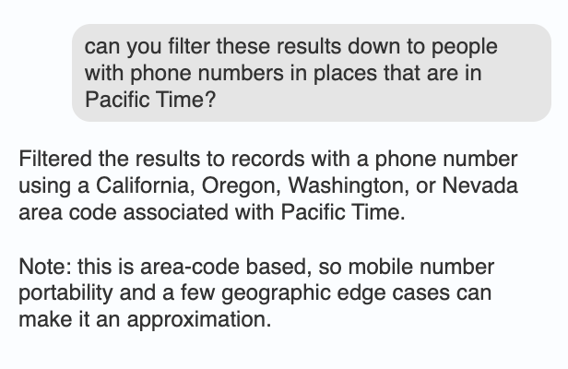
Dynamic Queries

Slide 30
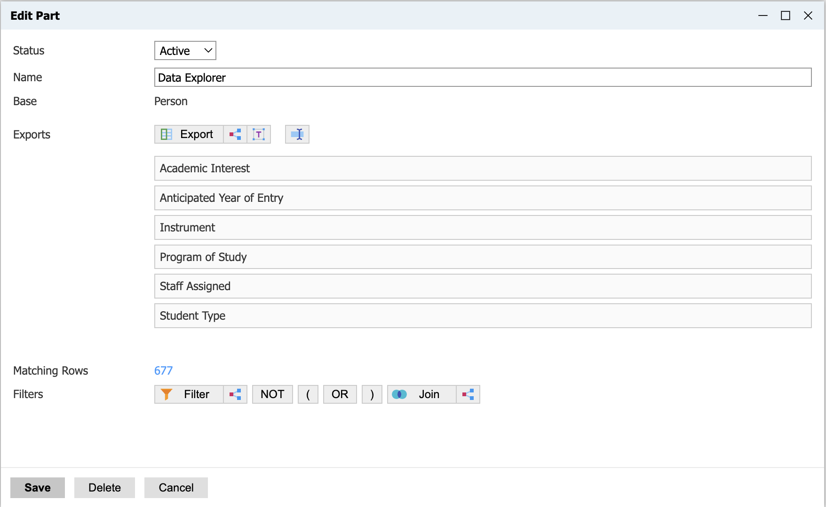
AI Data Explorer
      The biggest improvement in report building in Slate
      Highlights the benefits of conversational AI

Slide 31
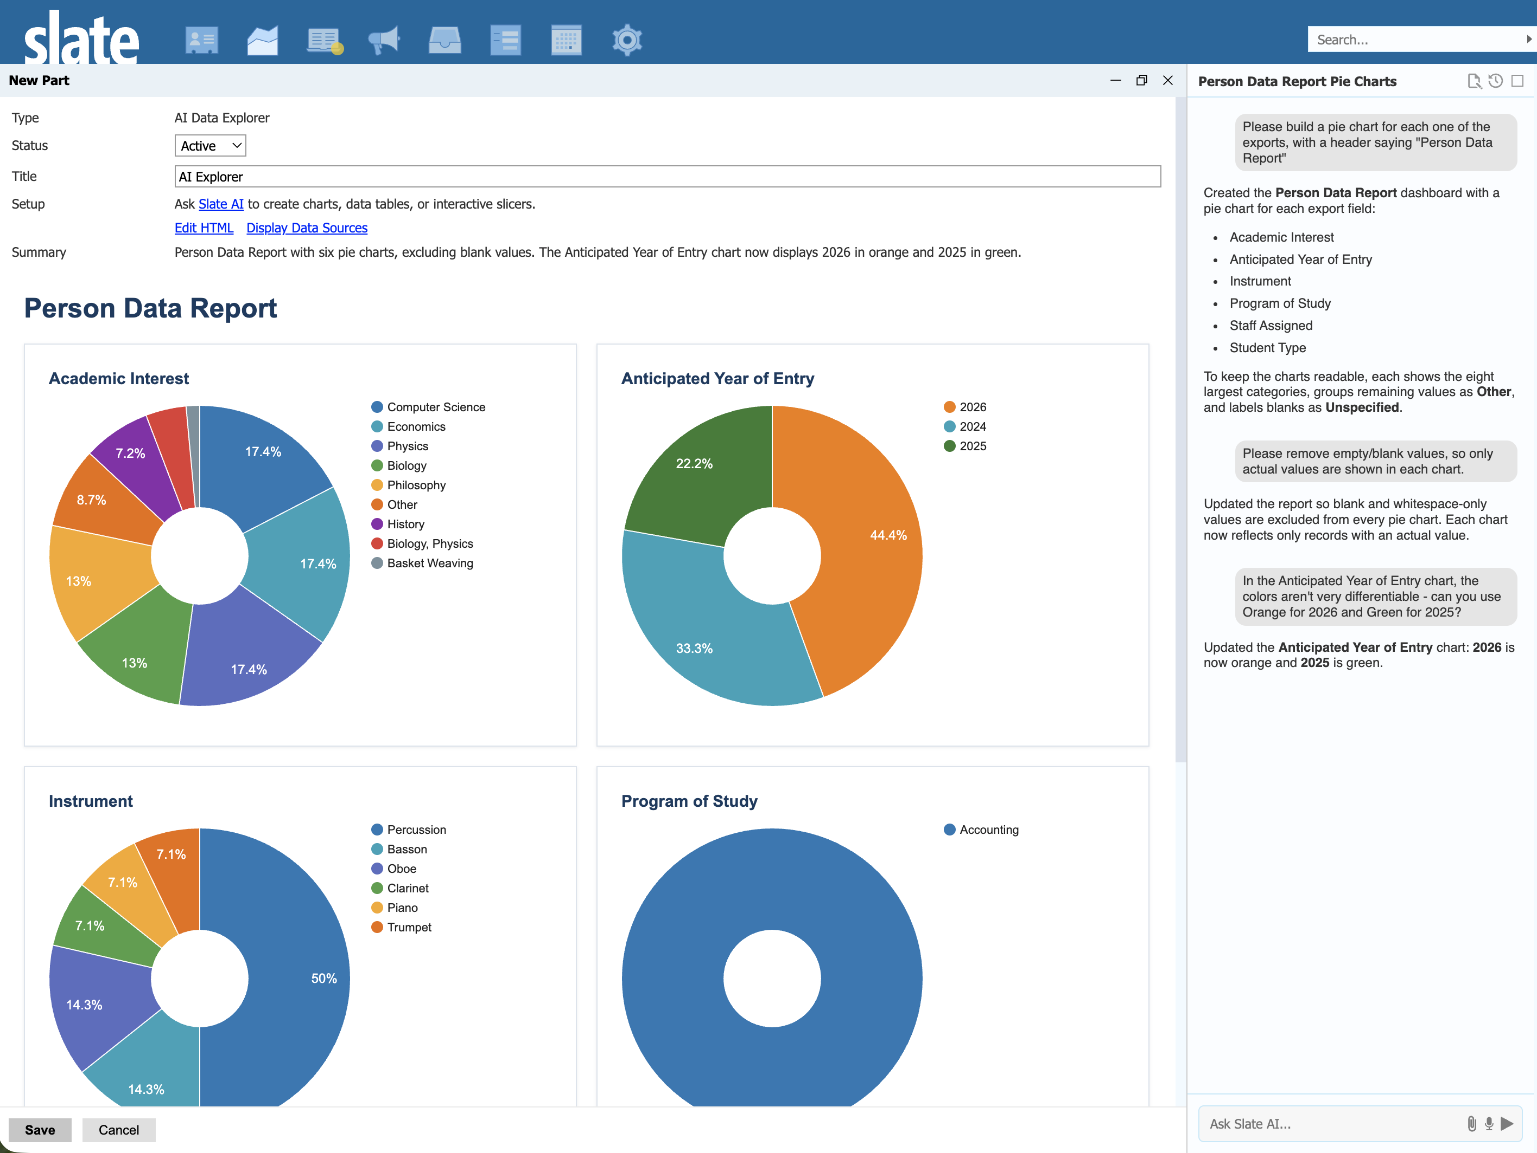
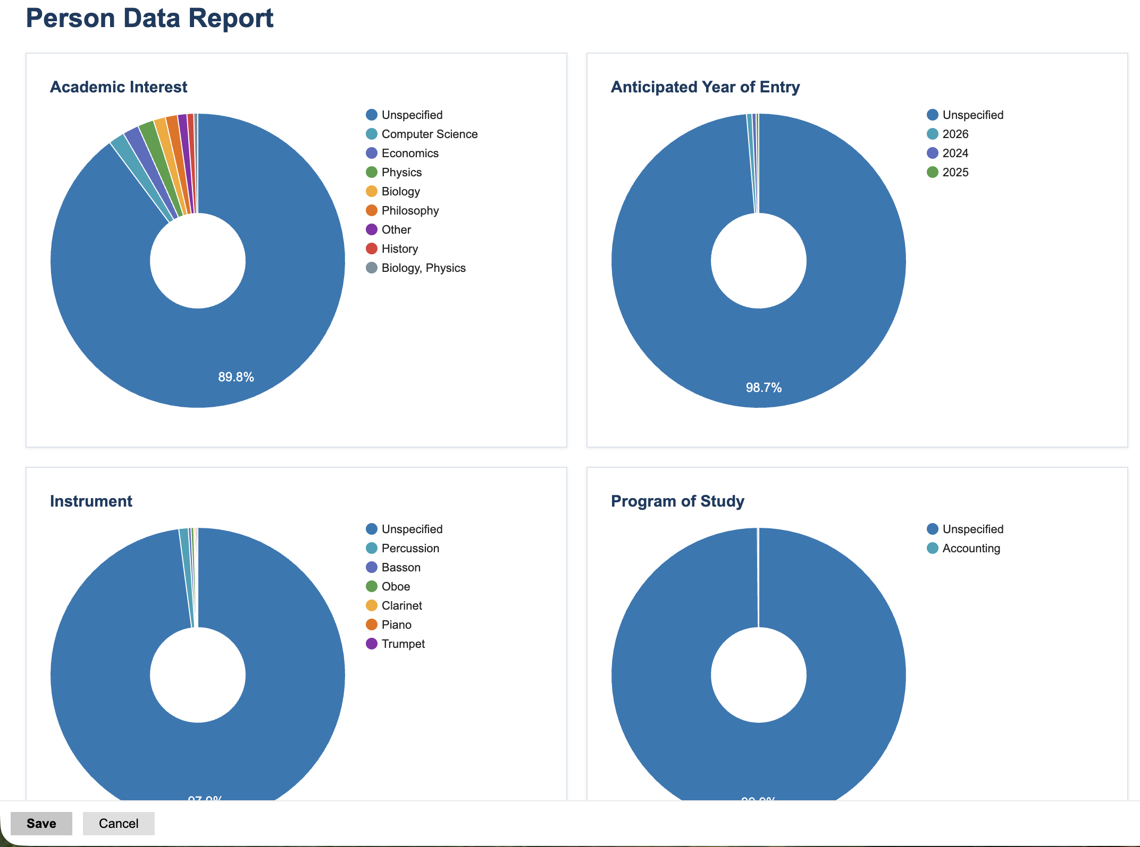
AI Data Explorer

Slide 32
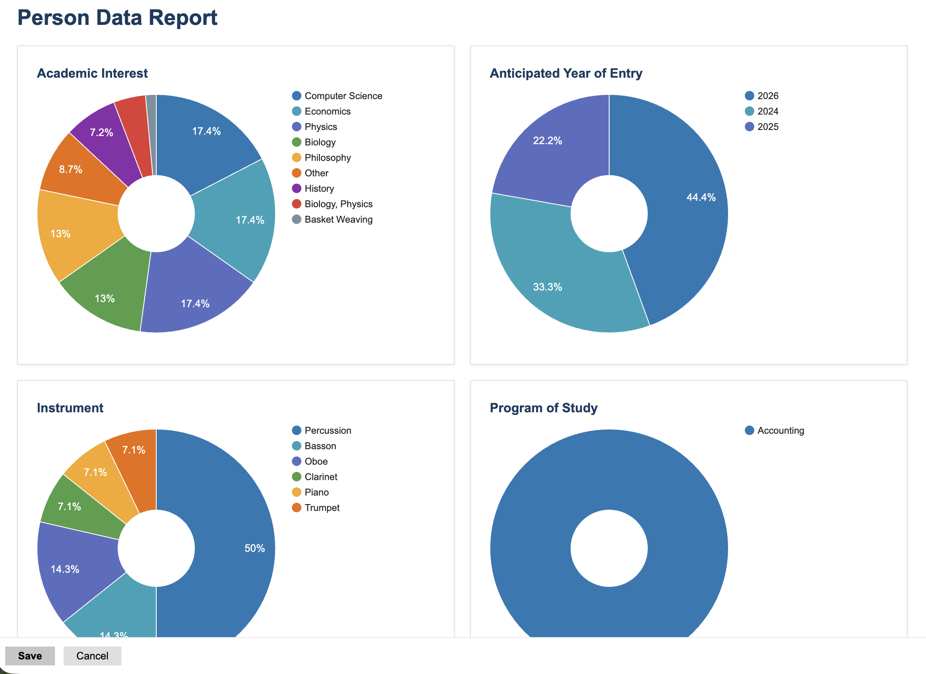
AI Data Explorer

Slide 33
AI Data Explorer

Slide 34
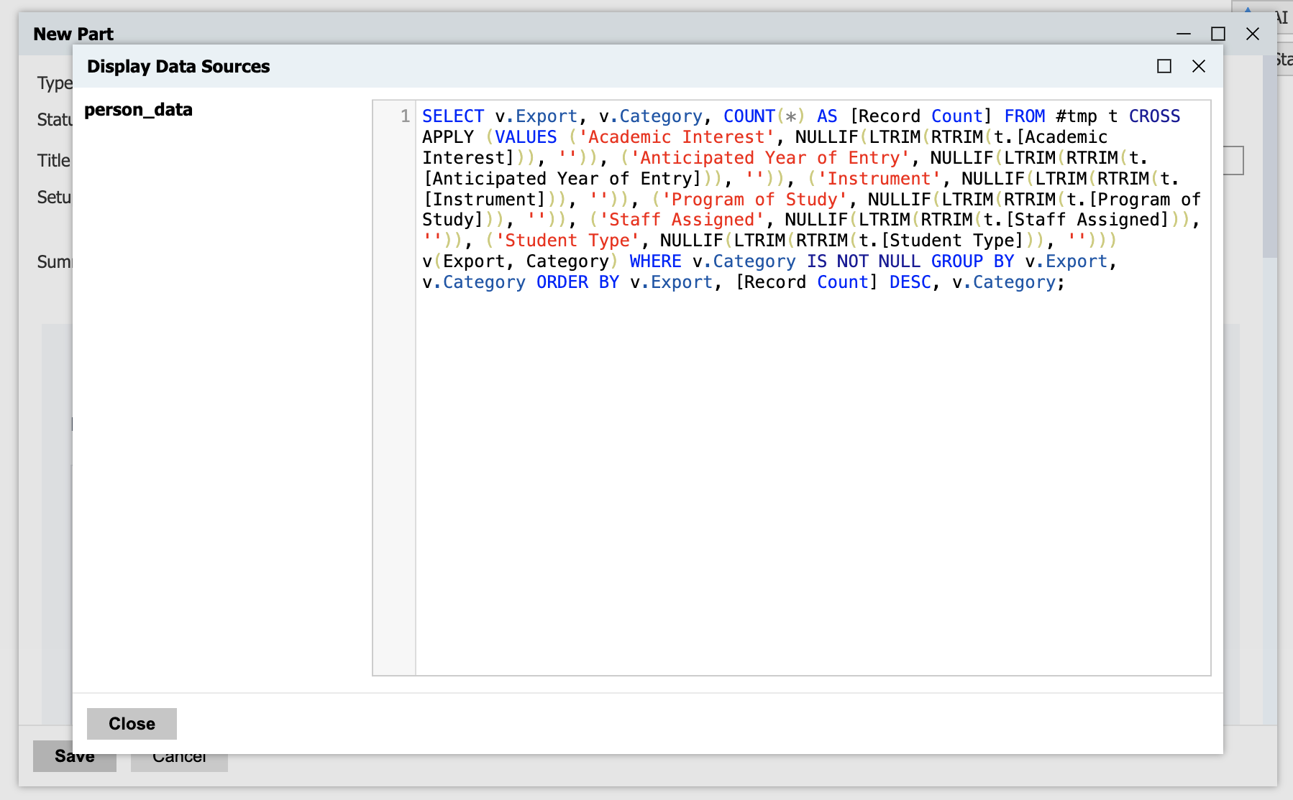
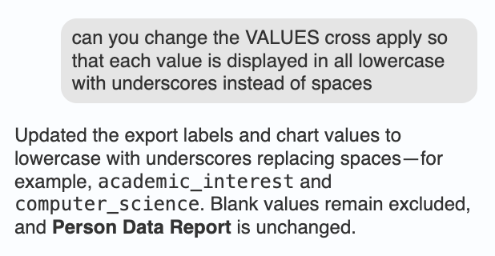
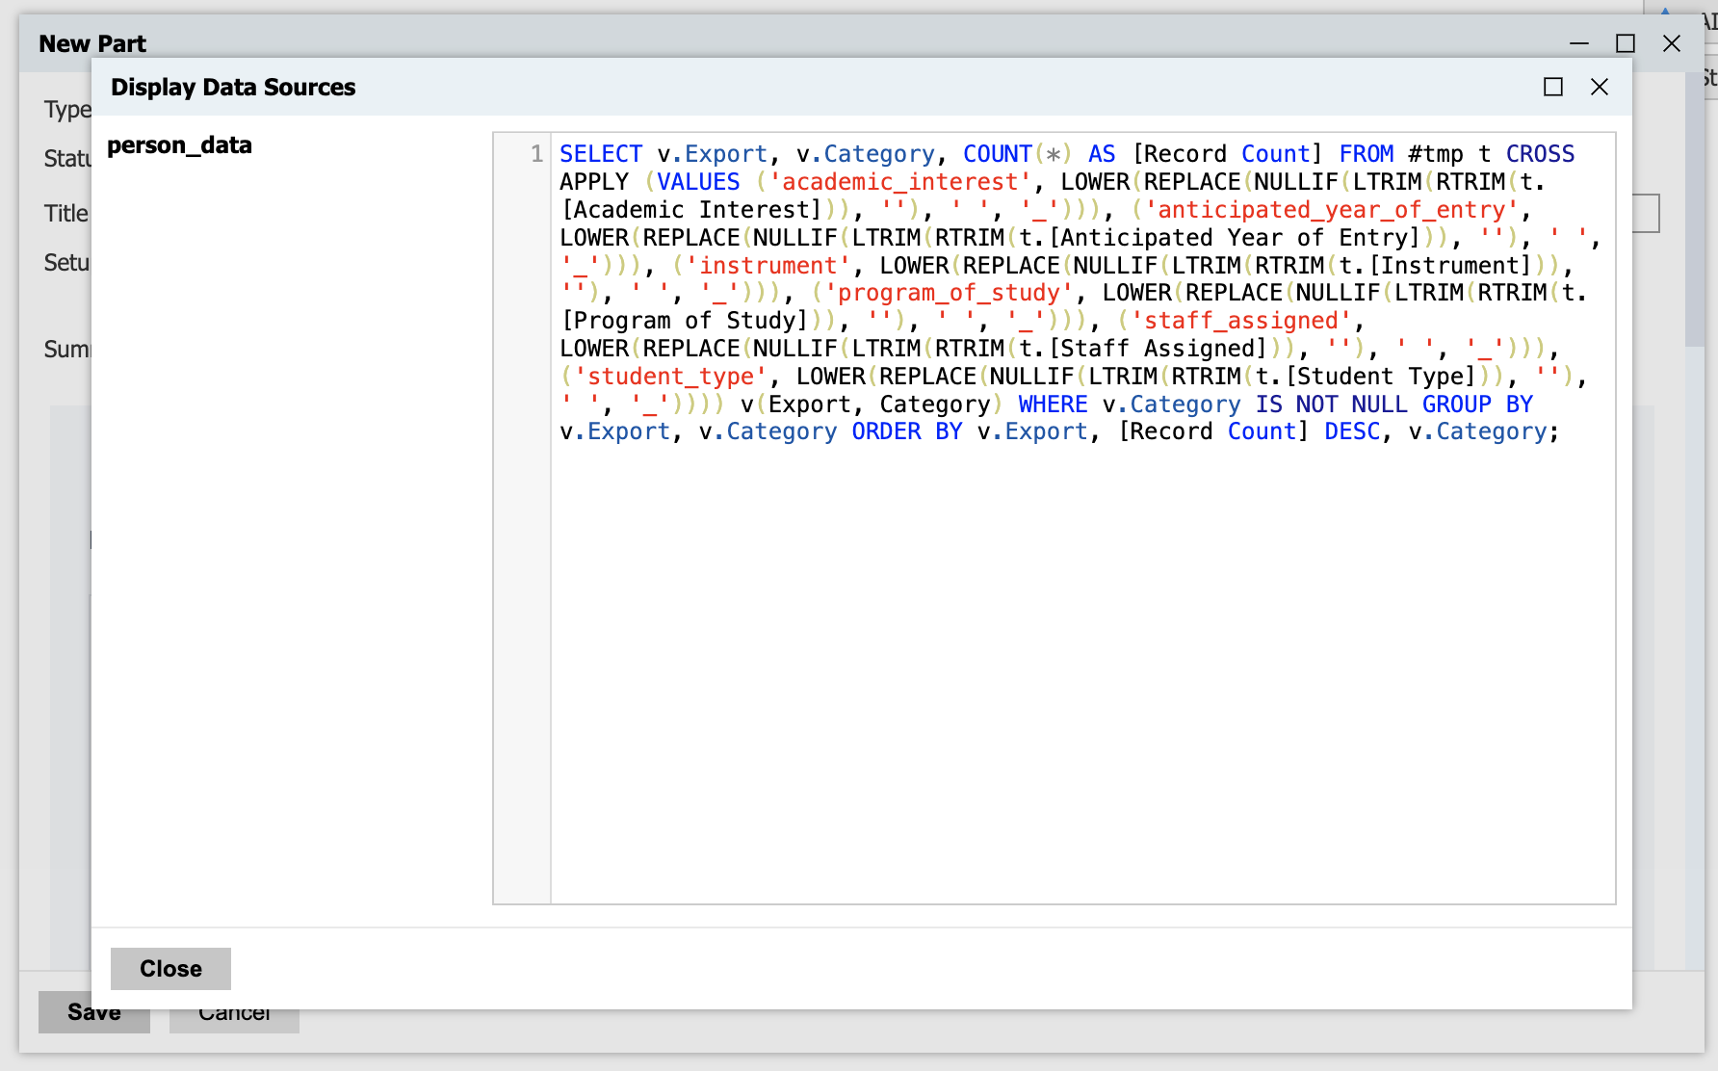
AI Data Explorer

Slide 35
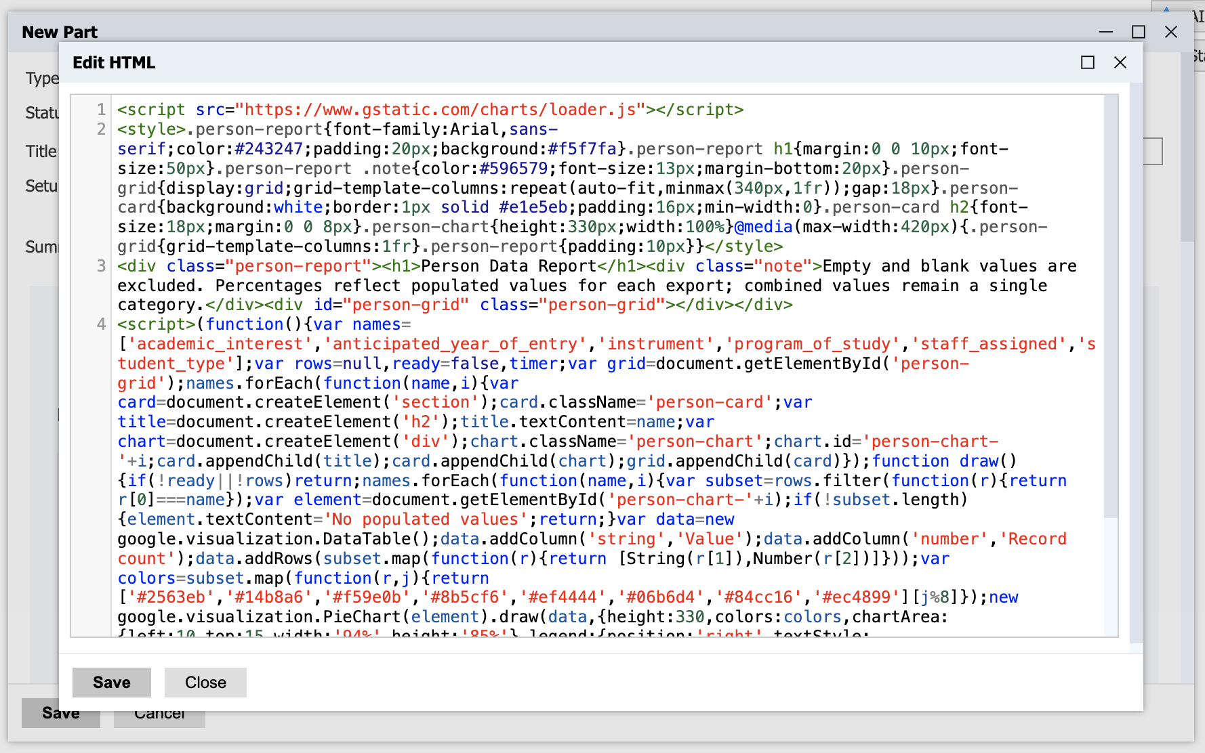
AI Data Explorer

Slide 36
Key Takeaways
      Tweaks throughout Slate make common actions simpler
      More customization with portals and tabs
      Use AI to automate manual processes
      Have a conversation with your data

Slide 37
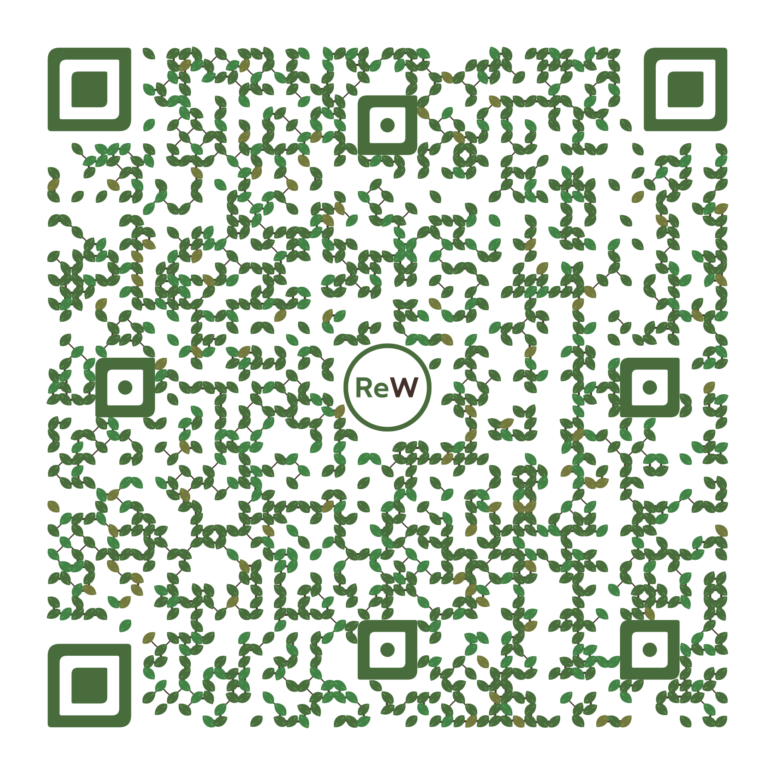
Questions
Download this PPT
Max Zeryck
Senior Slate Developer
mzeryck@ReWorkflow.com | ReWorkflow.com

