Slide 1


Slate Events
Unlocked
Building events from the ground up — templates, forms, comms, and check-in.
STAG

Slide 2
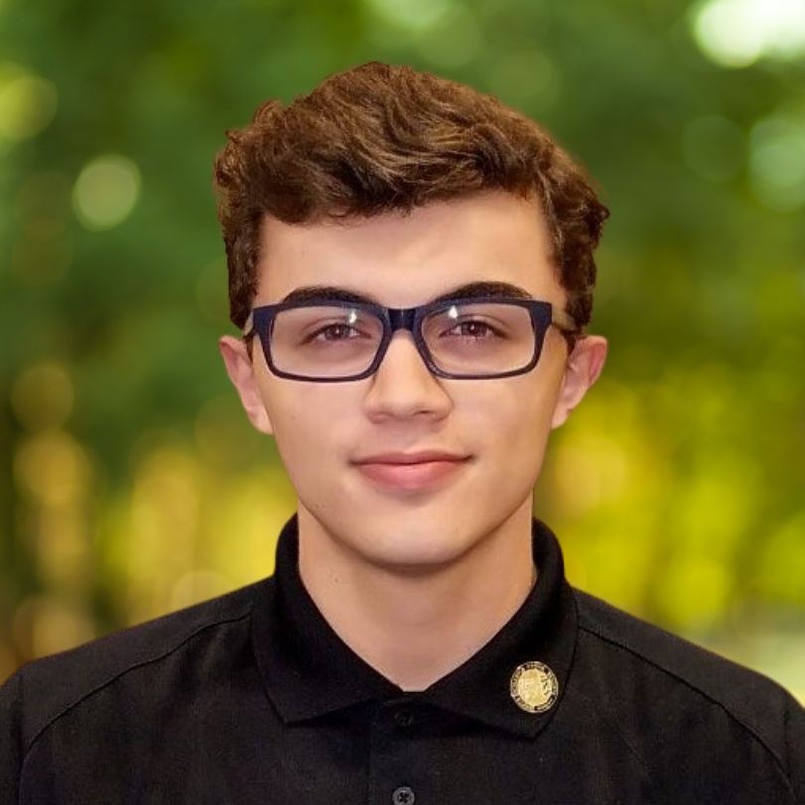
ABOUT THE PRESENTER
Bailey Raffield
Slate Developer | ReWorkflow
Slate Developer at ReWorkflow, a Preferred Partner specializing in Slate implementation and optimization for higher education institutions. With over a decade of experience in higher ed and 5+ years of Slate admin expertise, Bailey has supported universities across the country in building and refining their Slate environments. Prior to consulting, Bailey built a foundation in IT and Slate across roles at Texas A&M University and Valdosta State University.
10+
5+
ReW
Years in Higher Ed
Years Slate Admin
Preferred Partner

Slide 3
What We're Covering Today
AGENDA
01
What Are Events in Slate?
Overview of the event object and key concepts
02
Building an Event
Configuration settings from top to bottom
03
Registration Form Setup
Form properties, fields, logic, and best practices
04
Event Communications
Types, merge fields, triggers, and iCal
05
Event Check-In
Methods and best practices

Slide 4
01
What Are Events in Slate?
Understanding the event object and how it fits into your workflow

Slide 5




Events in Slate — The Big Picture
WHAT ARE EVENTS?
Whether you're running a one-time info session or a recurring campus tour, Slate gives you the tools to manage registration, automate your communications, and handle waitlists without lifting a finger.
Scheduling
Communications
Start/end dates, timezone, activation & deadline
Automated pre/during/post-event messaging
Registration
Check-In
Custom forms capture registrant data & preferences
Track attendance and manage waitlists in real time

Slide 6
Template vs. Singular Event
WHAT ARE EVENTS?
The first decision you make: should this event use a template?
Event Template
Singular Event
Reusable across multiple event instances
Inherit shared settings: form, comms, location
Great for recurring events (campus tours, info sessions)
Manage once and changes flow to all linked events
Standalone — no template needed
Configured entirely from scratch
Best for one-off or unique events
Full control without inheritance constraints
💡 Pro tip: If you'll run the same event more than twice a year, build a template first.

Slide 7
02
Building an Event
Walking through event configuration settings from top to bottom

Slide 8
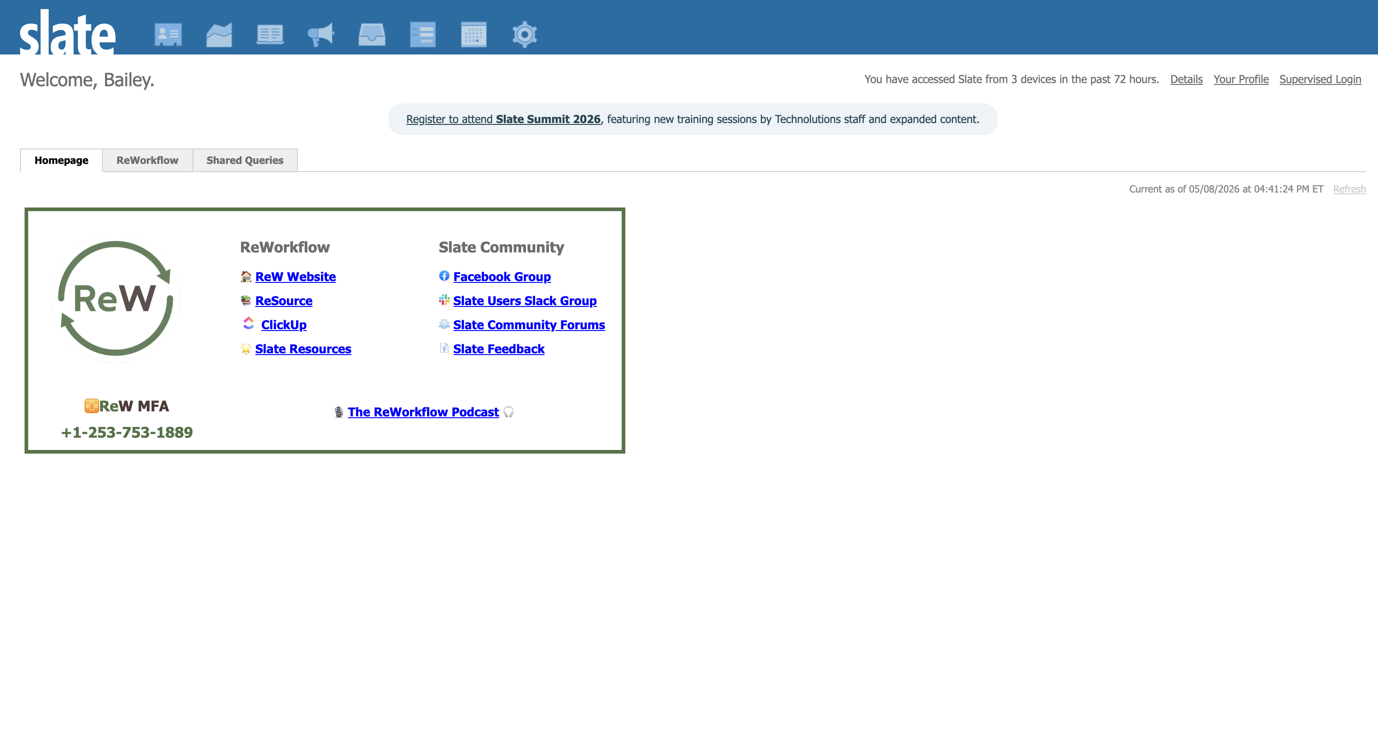
How to Navigate to Events
VISUAL REFERENCE
[ Add Screenshot Here ]

Slide 9
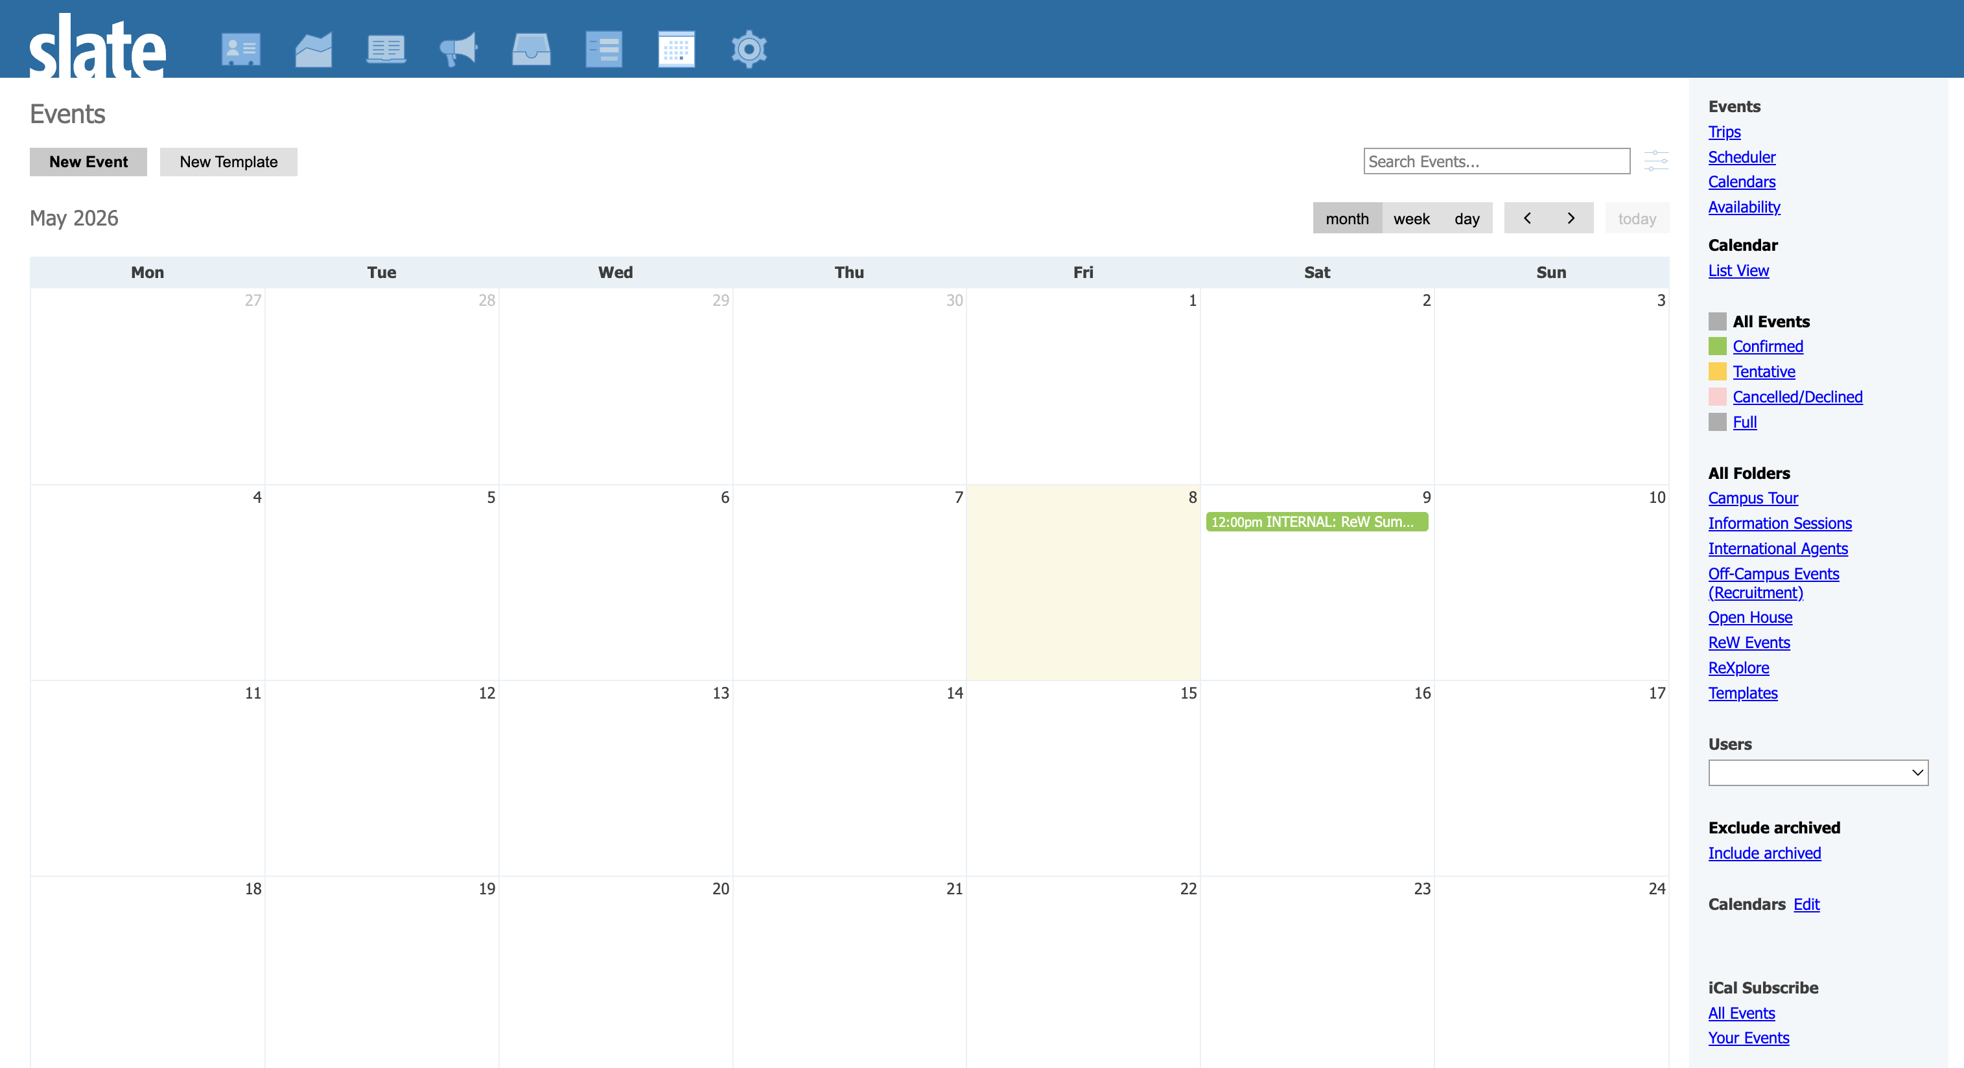
Where to create a new event/template
VISUAL REFERENCE
[ Add Screenshot Here ]

Slide 10
Core Event Settings
BUILDING AN EVENT
The top-level fields that define your event identity and timing.
Internal Event Title
Used inside Slate only — be descriptive for your team
Event Title
What registrants see on forms and communications
Status
Controls visibility: Tentative, Confirmed/Active, Declined, or Cancelled
Start & End Dates
Date/time of the actual event — drives iCal and displays
Activation Date
When the registration form becomes accessible to visitors
Deadline Date
Cutoff for new registrations
Timezone
Critical for multi-location or virtual events — always set this

Slide 11
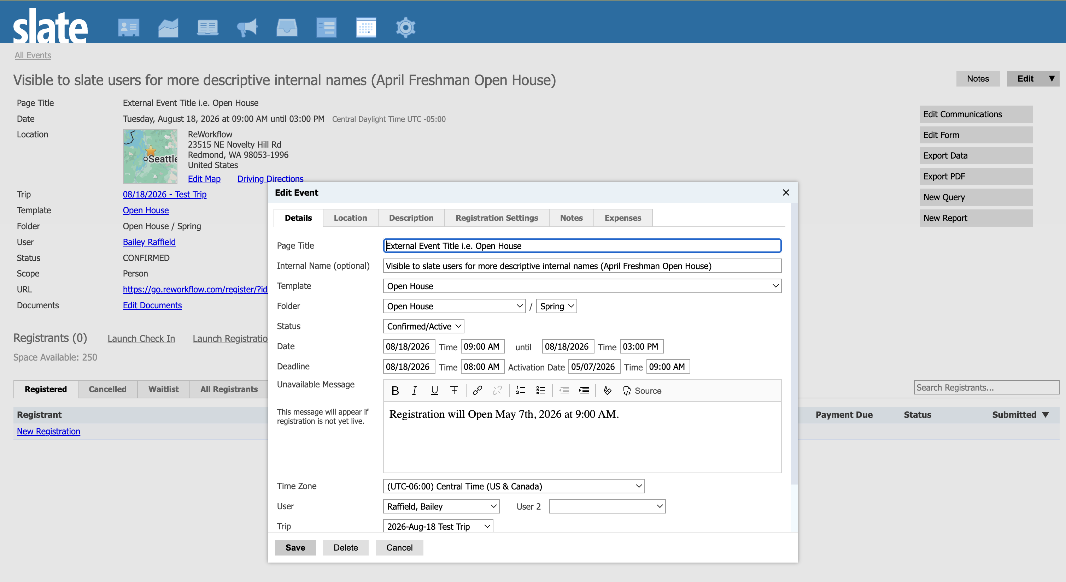
Event Details
VISUAL REFERENCE
[ Add Screenshot Here ]

Slide 12




Assignment & Notification Fields
BUILDING AN EVENT
User
Trip
Assigns ownership of the event to a specific Slate user. Drives reporting and filtering.
Links the event to a recruitment trip record. Useful for grouping events by travel itinerary and tracking costs together.
Admin Notify
Related Records
Sends an internal email alert to a specified address when a new registration is submitted or updated. Great for small-team awareness without building a full export.
Associates the event with other Slate records (e.g., a school or organization). Useful for partnership events or external site visits.

Slide 13
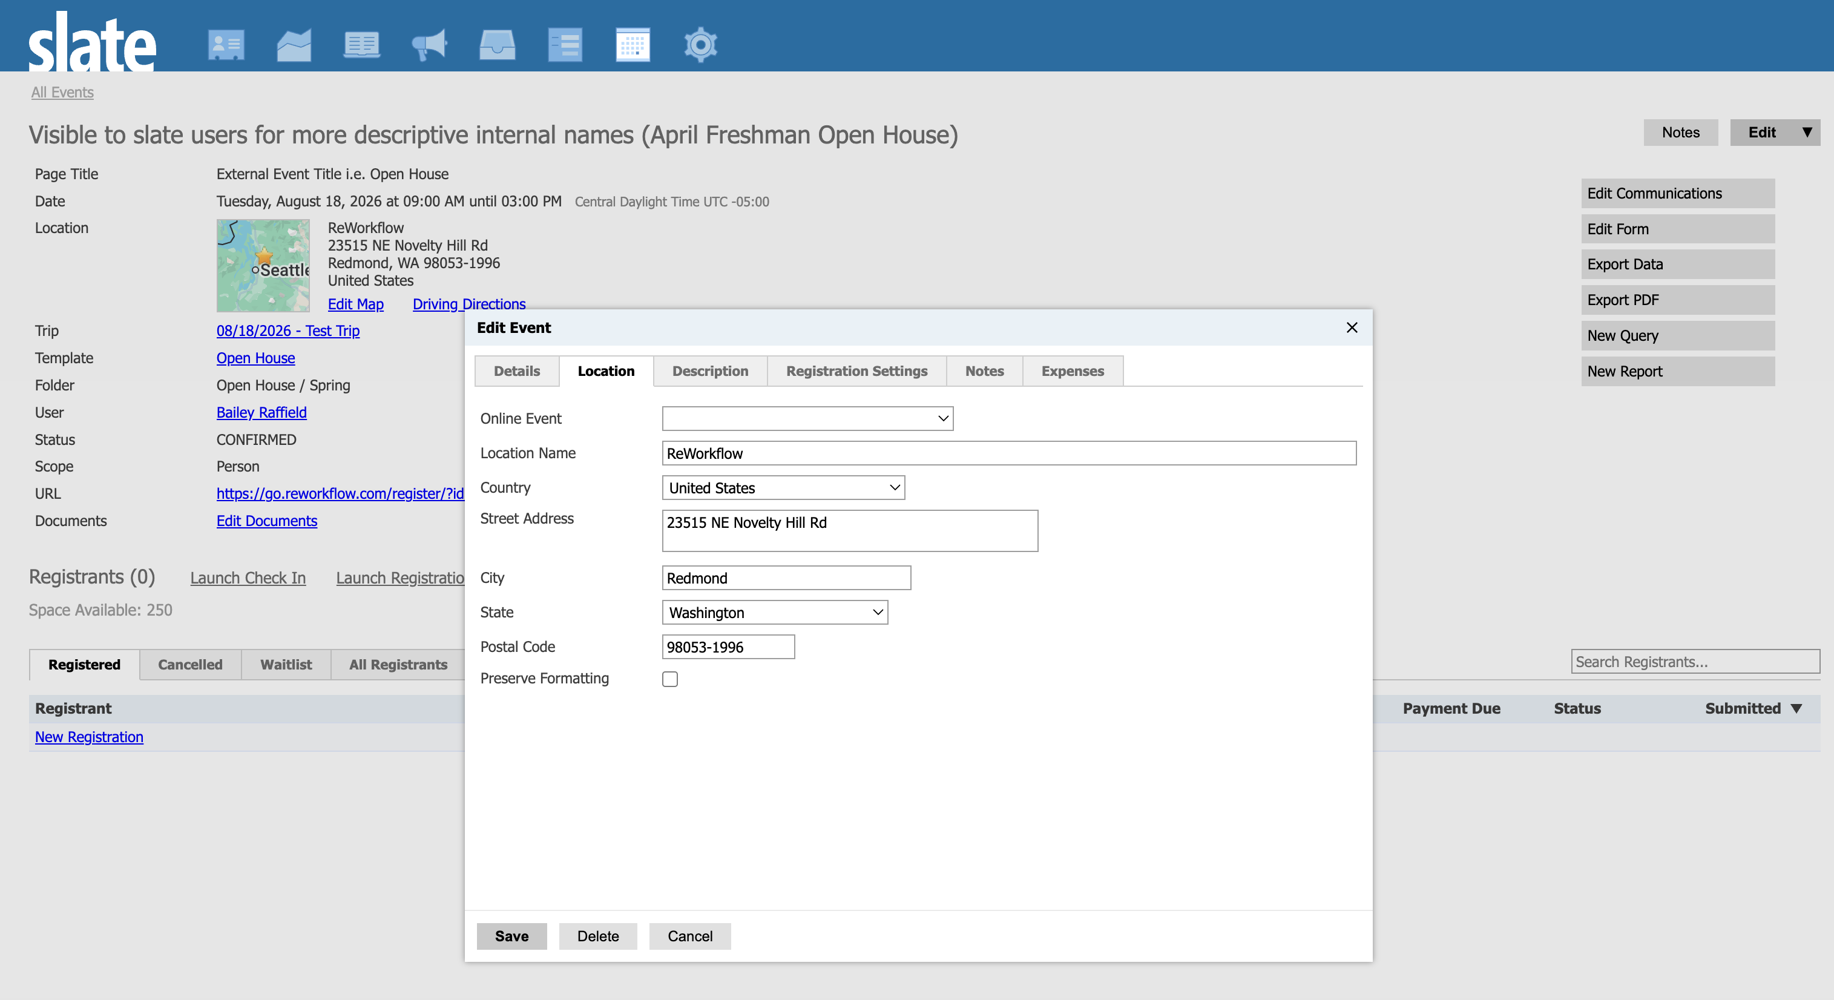
Event Location
VISUAL REFERENCE
[ Add Screenshot Here ]

Slide 14
Location Configuration
BUILDING AN EVENT
Slate gives you three location modes allowing you to configure to your needs.
In-Person Location
Online via Slate Share Webinar
External Online Service
Location Name
Address / Venue details
Preserve Formatting (for rich-text addresses)
Description (optional context for registrants)
Location Name
Waiting Room Content
Early Access window (minutes before start)
Slate hosts the webinar platform natively
Location Name
URL (Zoom, Teams, etc.)
Instructions for joining

Slide 15
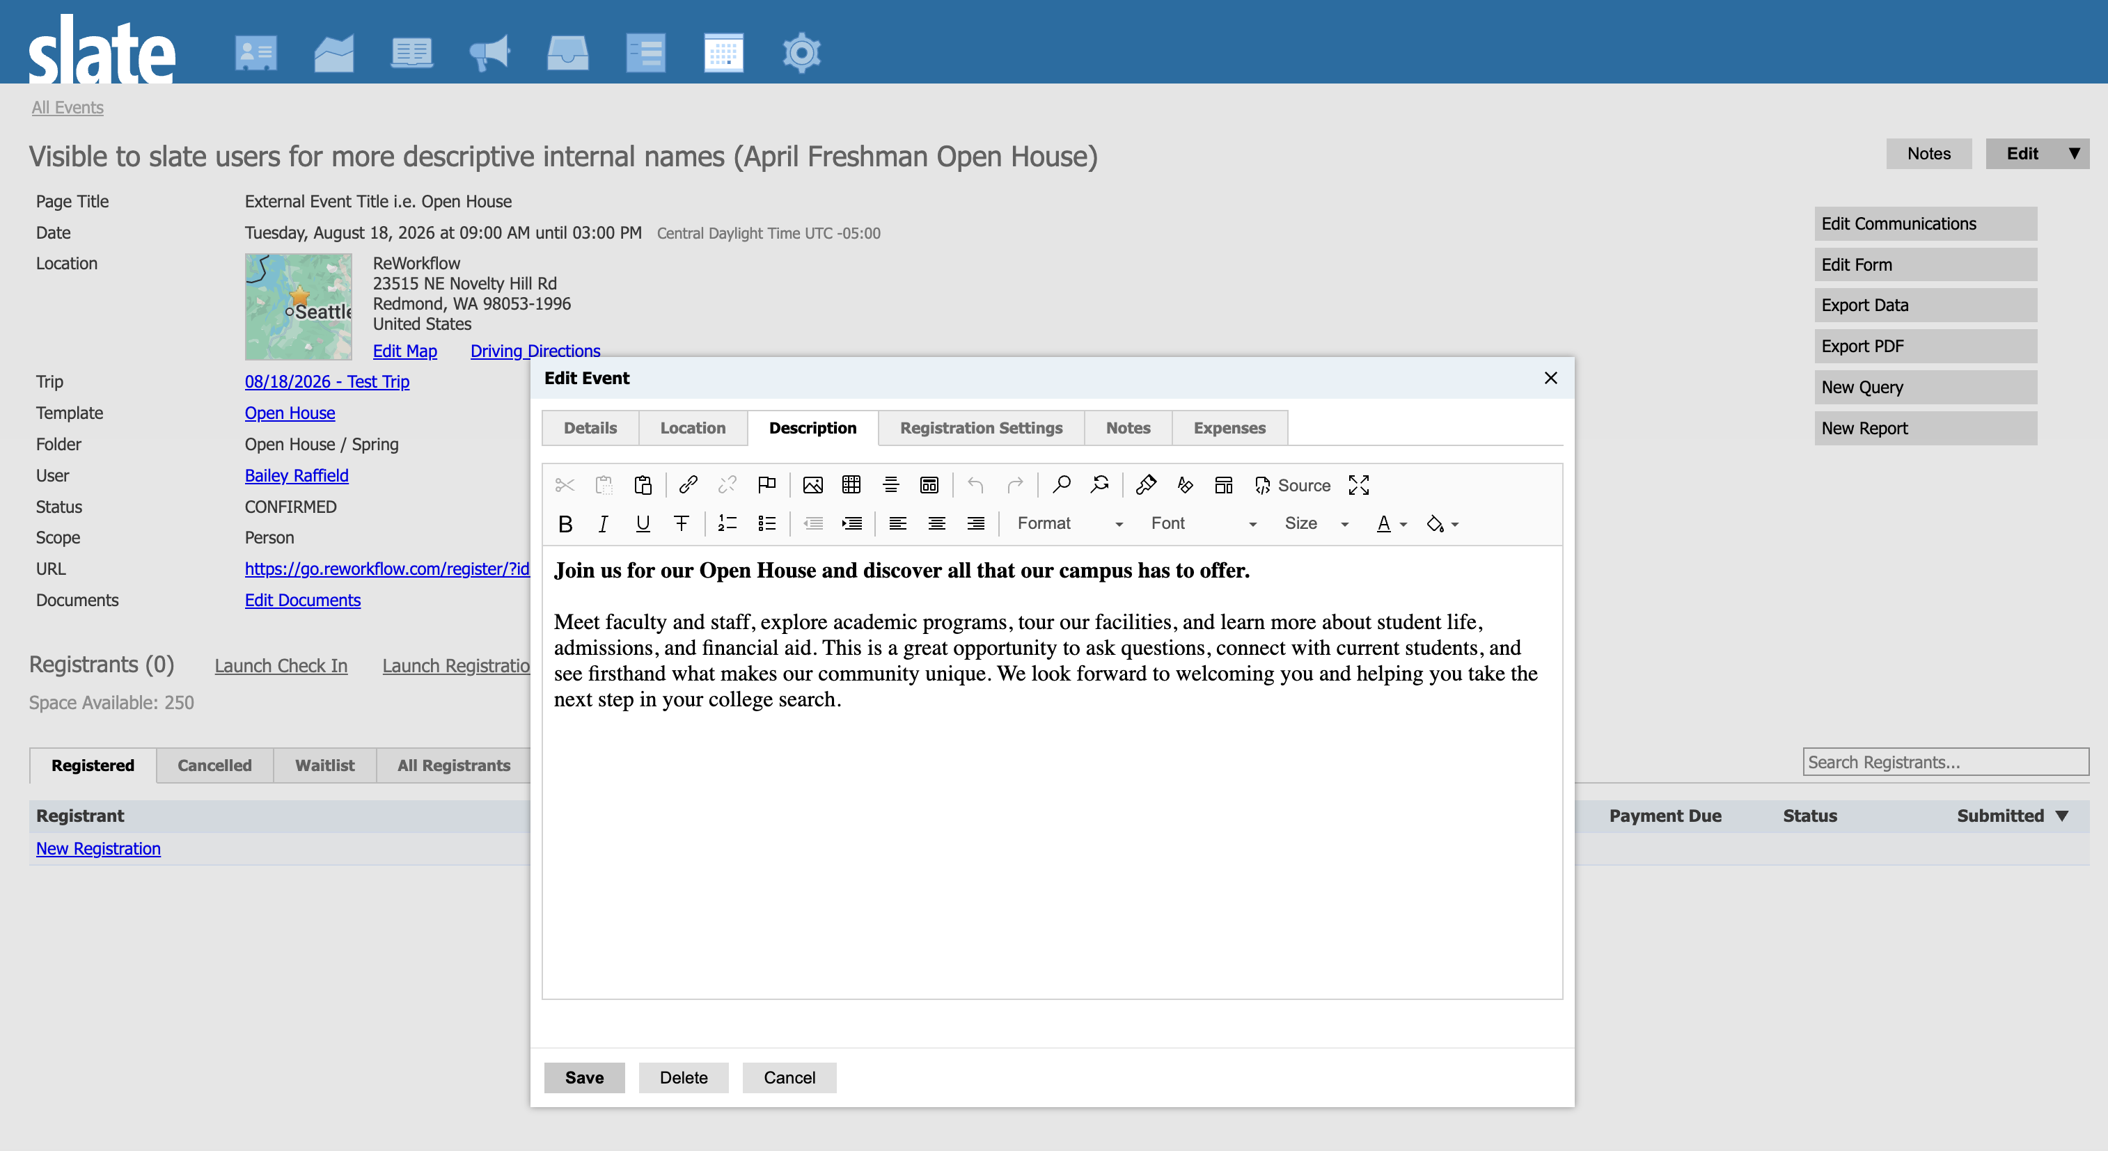
Event Description
VISUAL REFERENCE
[ Add Screenshot Here ]

Slide 16
Registration Settings
BUILDING AN EVENT
Control capacity, guests, waitlists, and privacy.
Registrant Limit
Maximum number of registrations accepted
Include Guests
choose to include guests in the registration limit
Custom Limit Message
Shown when capacity is reached, customize for your audience
Waitlist Limit
Cap on the waitlist itself; optional, set 0 for unlimited
Waitlist Transfer
Auto-promotes waitlisted registrants when a spot opens
Waitlist Message
Custom message shown to registrants placed on the waitlist
Related Registration Checkin
Links Main Event check-in activity to an related event's registration record
Attendance Override
Enter the number of actual attendees for the event to override the number of registrations.
Privacy
Controls who can see this event — internal, public, or restricted

Slide 17
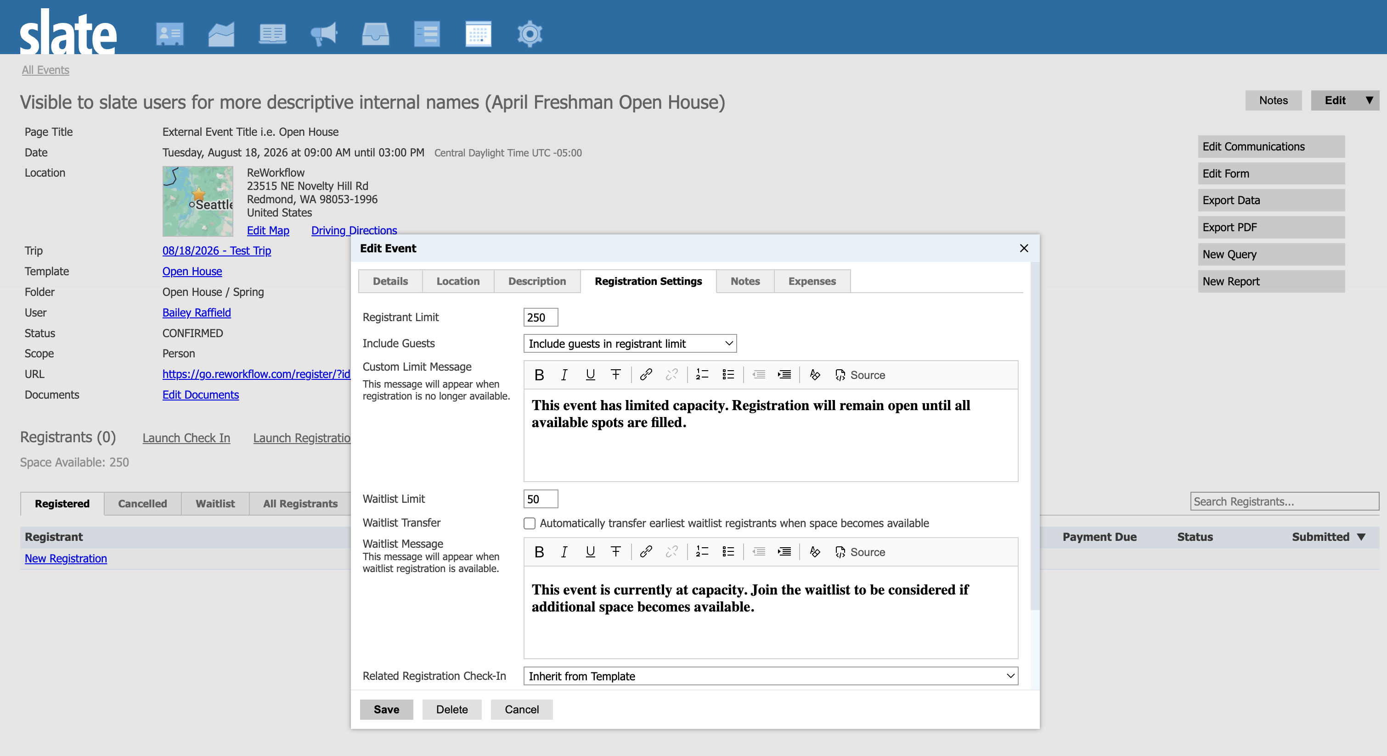
Event Registration Settings
VISUAL REFERENCE
[ Add Screenshot Here ]

Slide 18



Additional Event Tab Settings
BUILDING AN EVENT
Beyond the main config panel, these tabs give you extended control.
Timeline
Event Portal
Hides event registration entries from the records timeline. Only use when registration needs to be hidden from record timeline tab.
Makes events visible on slate standard Registrant-facing portals.
Notes
Expenses
Internal notes attached to the event record — visible only to your team inside Slate.
Track costs associated with the event directly on the record. Useful for budget reconciliation and trip cost reporting.

Slide 19
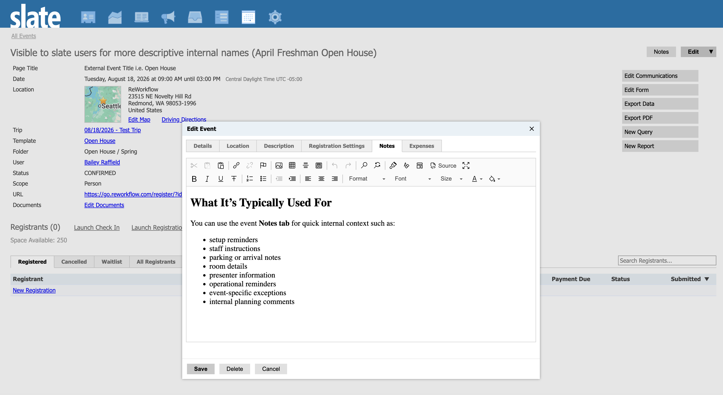
Event Notes
VISUAL REFERENCE
[ Add Screenshot Here ]

Slide 20
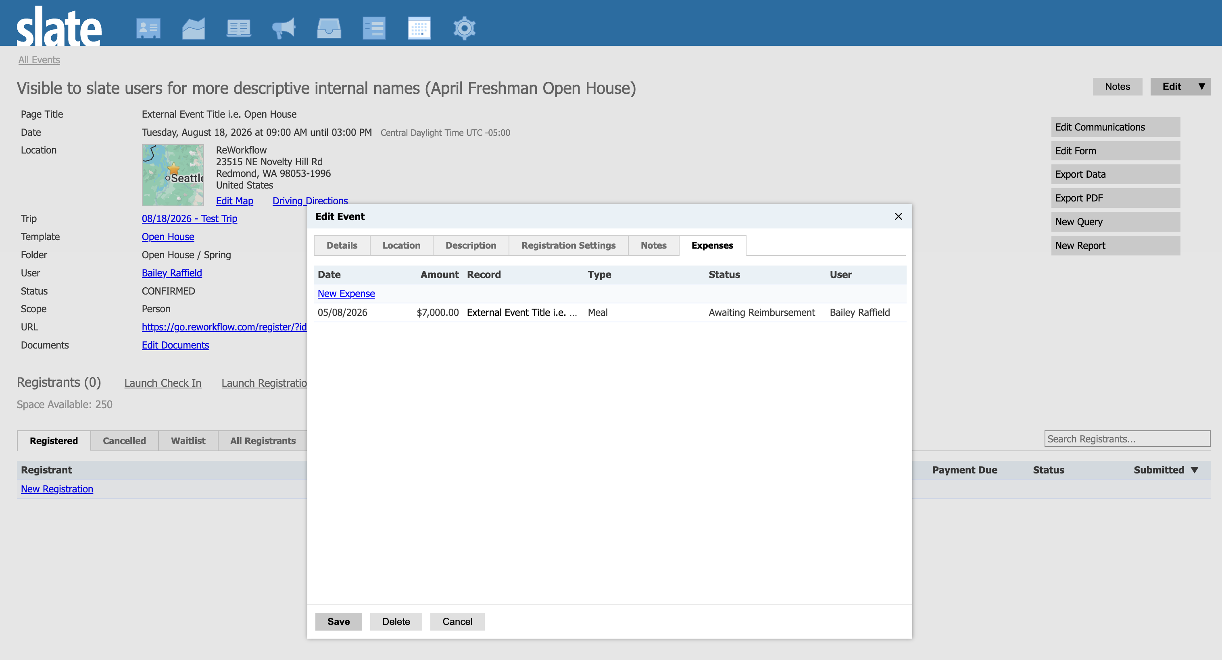
Event Expenses
VISUAL REFERENCE
[ Add Screenshot Here ]

Slide 21
03
Registration Form Configuration
Form properties, fields, logic, and best practices

Slide 22
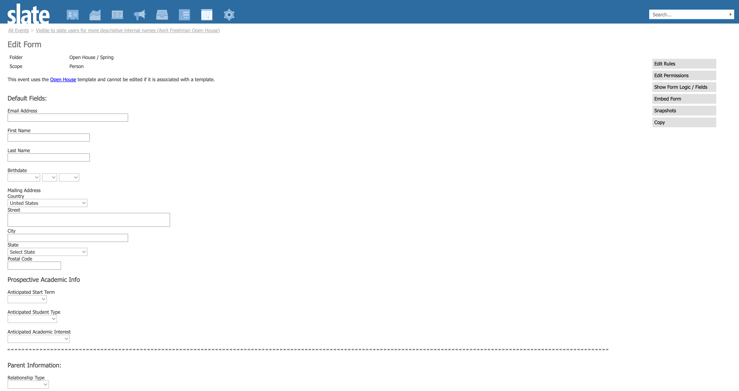
Event Form Editor
VISUAL REFERENCE
[ Add Screenshot Here ]

Slide 23
Edit Properties — Form Settings
REGISTRATION FORMS
The properties panel controls how your form behaves at a fundamental level.
Scope
Person, Application, etc. — determines what record the form writes to
Multiple
Allow one person to register more than once for this event
Unsafe
Allows record updates upon form submission when a record already has an application(use carefully)
Security
Controls access: public, authenticated, or restricted audiences
Update Only
Only updates existing records. Won't create new ones
Survey
Allows selection of a survey form for the event. Also allows the setting of survey submission duration
Notes Form
Links a event notes form to event. Helpful for collecting more settings or info about a event
Layout
Controls stacked vs. table visual layout
Export Value
Assigns a exports for the event form

Slide 24
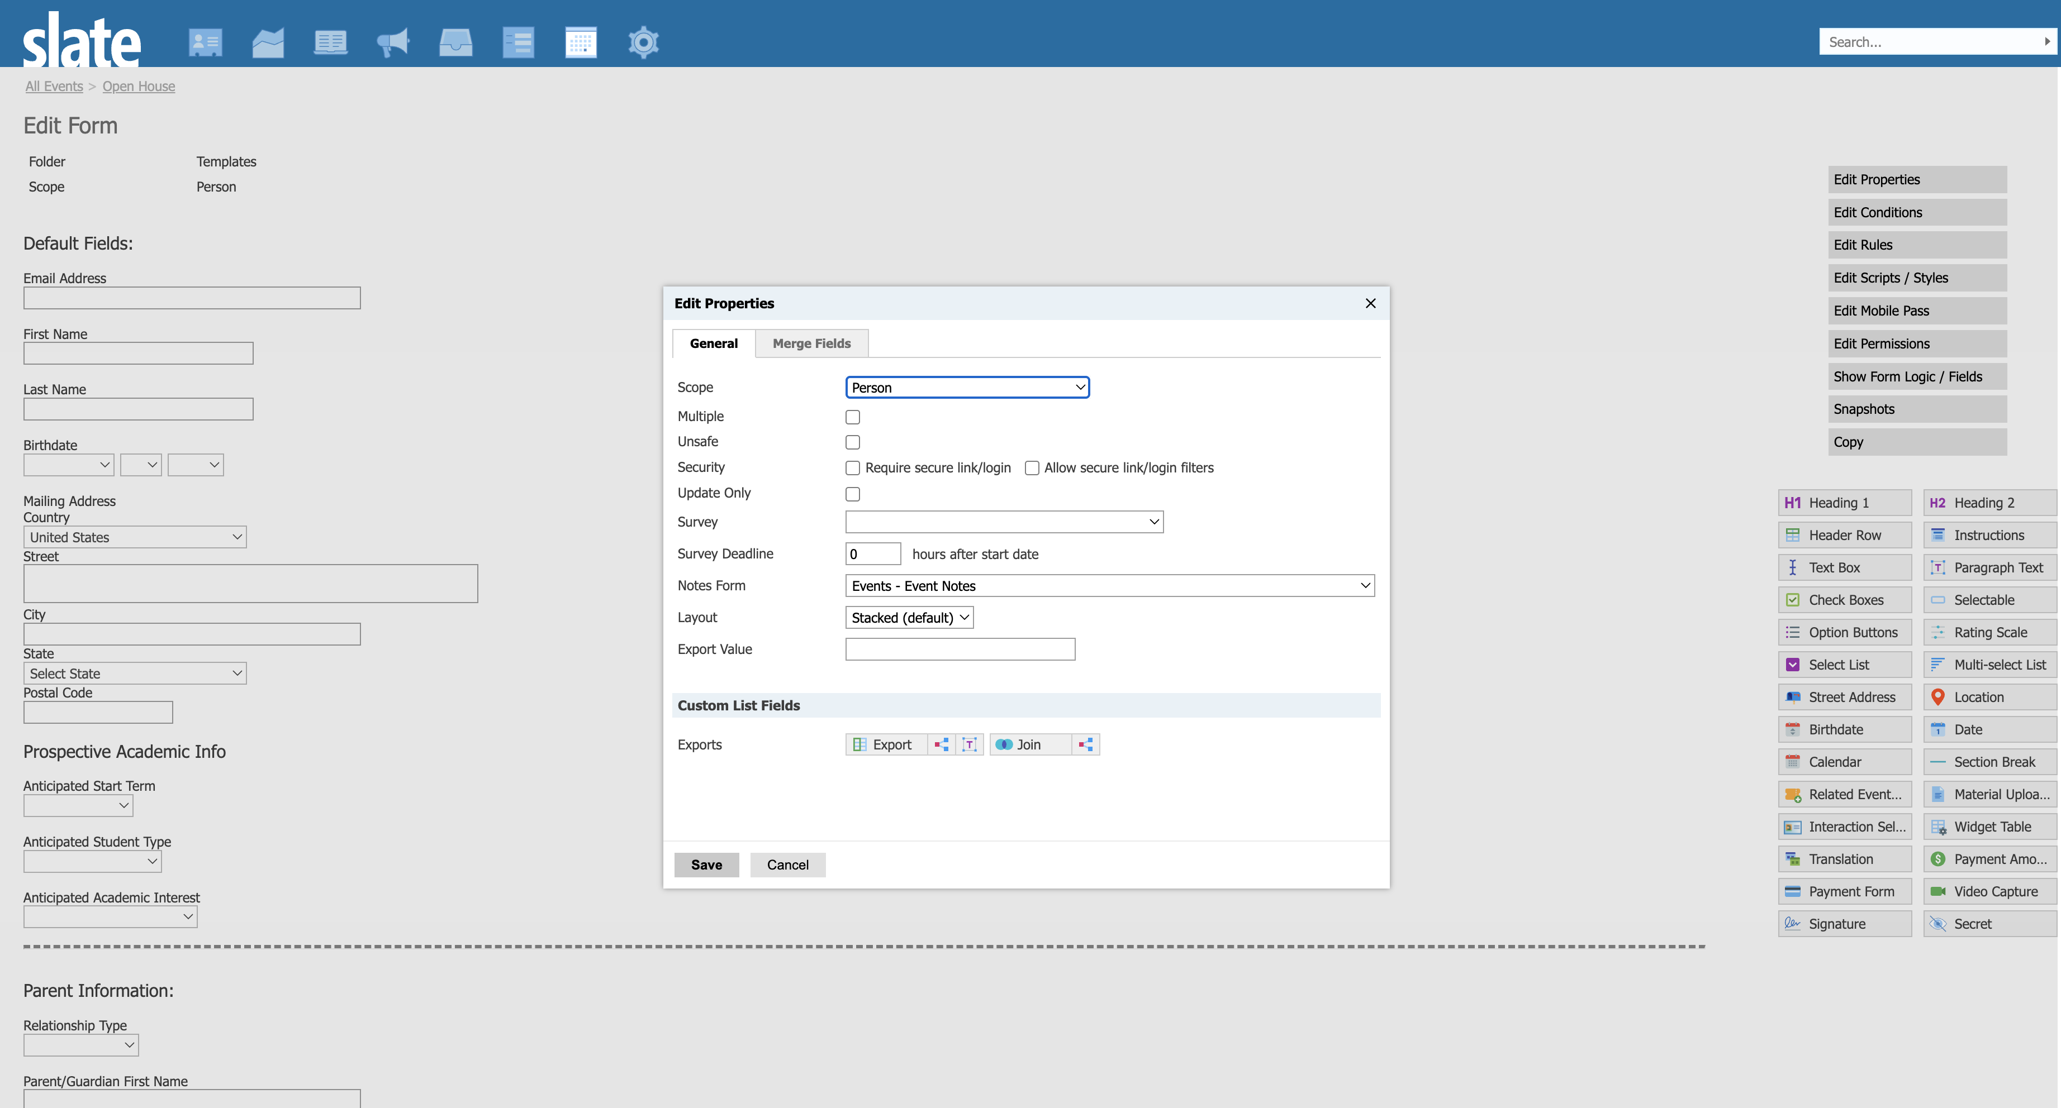
Edit Properties
VISUAL REFERENCE
[ Add Screenshot Here ]

Slide 25
Form Fields — Mapped vs. Unmapped
REGISTRATION FORMS
Understanding the two main types of form fields and when to use each.
Mapped Fields
Unmapped Form Fields
Mapped fields are form fields connected to a Slate record, such as a person, application, or address field.
Write directly to record tables in slate upon form submission
Can be added to forms/events to collect important datapoints.
Use prompt lists to collect standardized data across system
Unmapped form fields collect information on the form submission only and do not write back to the main Slate record.
Created and managed by your team on forms/events
Quarriable via Form Response Table
Available as merge fields in form/Event communications
Can be used for conditional logic (show/hide based on answers)
Example: Session preference, T-shirt size, Dietary restrictions

Slide 26
Conditional Logic & Pagination
REGISTRATION FORMS
Two powerful tools that shape the registrant experience.
Conditional Logic (Edit Conditions)
Show or hide fields based on answers to previous questions. Applies to individual fields AND to entire form sections.
Example: Only show 'Dietary Restrictions' if the registrant selects 'Yes' for 'Will you attend the lunch session?'
Page Breaks / Pagination
Split long forms into multiple pages using page-break elements. Reduces cognitive load and improves completion rates.
Best practice: group related questions together and keep each page focused on one topic.

Slide 27
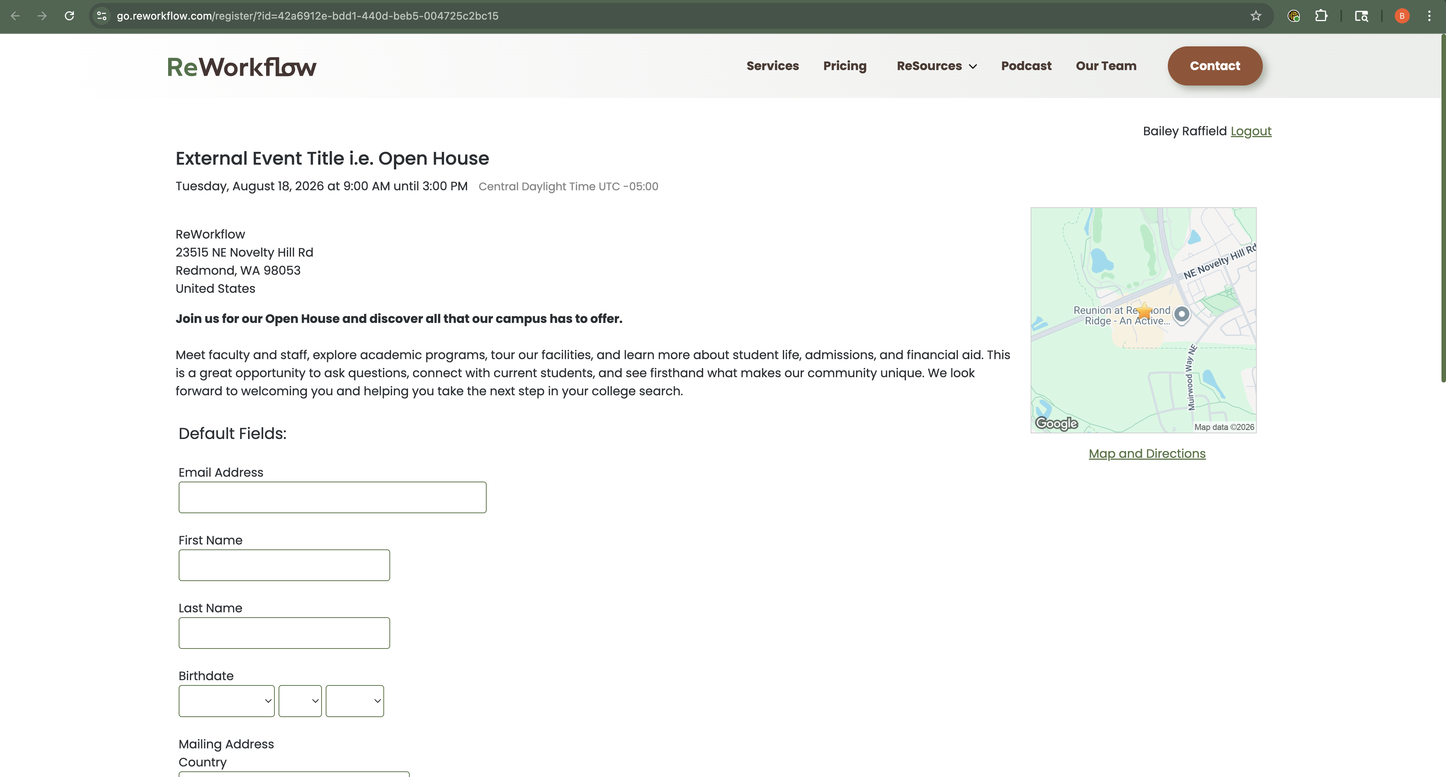
Public Facing Registration Form
VISUAL REFERENCE
[ Add Screenshot Here ]

Slide 28






Advanced Form Options
REGISTRATION FORMS
Conditional Filters
Form Rules
Edit Scripts
Restrict who can submit the form based on Slate record/form response criteria.
Automate actions on submission update fields, trigger communications, or route to workflows.
Custom JavaScript/CSS for advanced field behavior, validation, or pre-population logic.
Edit Mobile Pass
Edit Permissions
Embed Form
Configure an Apple Wallet / Google Pay pass for event check-in.
Control which Slate users can view, edit, or manage this form and its submissions.
Get the embed code to place the registration form on an external website.

Slide 29
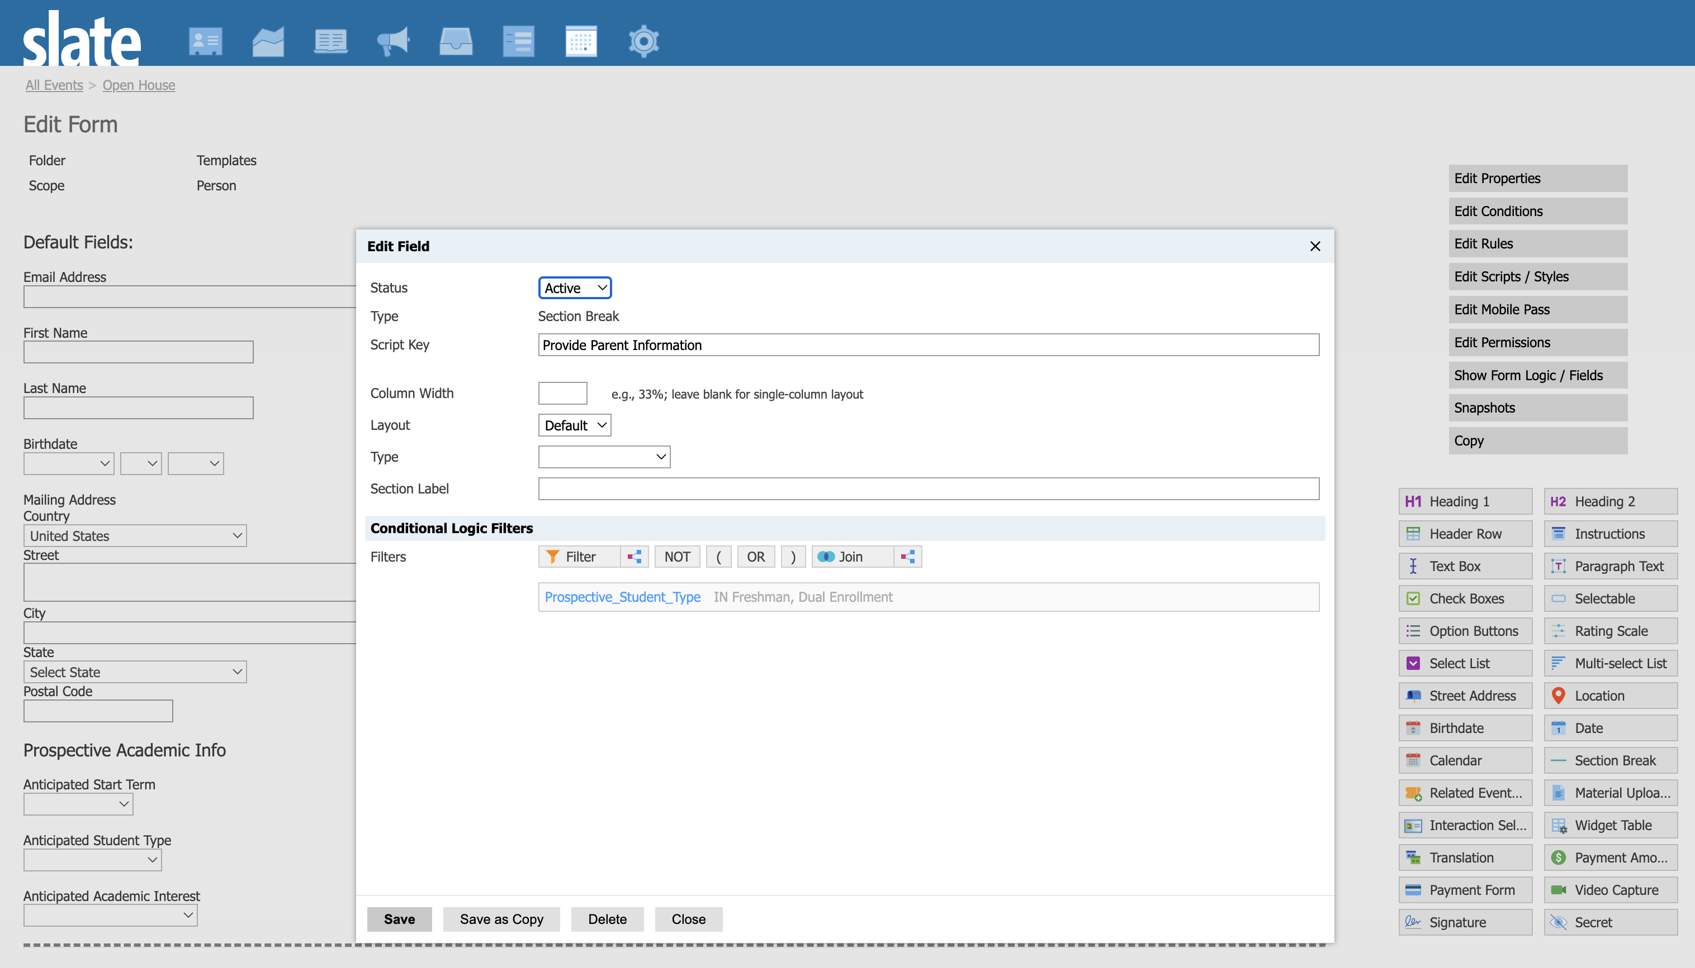
Page Breaks/Logic
VISUAL REFERENCE
[ Add Screenshot Here ]

Slide 30
Event Form Best Practices
REGISTRATION FORMS
01
Ask only what you'll use
Every extra field is friction. If you won't act on the data, don't collect it.
02
Use conditional logic generously
Don't show irrelevant questions. Conditional logic makes forms feel shorter and smarter.
03
Set a Scope intentionally
Person scope is most common. Application scope is powerful but complex — make sure it matches your use case.
04
Use an event notes form to store important datapoints
Use event notes form to store important information about events: Recording links, Faculty/Staff Assignments and much more.
05
Remember to add Unmapped Field Export Keys
Export keys are important for unmapped fields since those fields do not store data back to a Slate record. The export key gives the response a reusable name so it can be referenced in communications, merge fields, and queries.

Slide 31
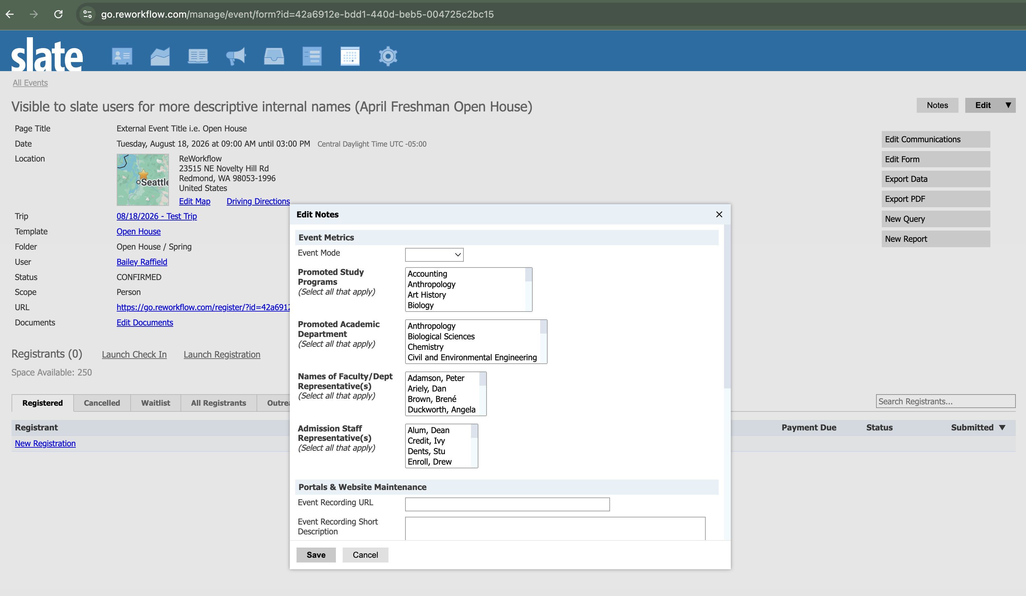
Event Notes Form
VISUAL REFERENCE
[ Add Screenshot Here ]

Slide 32
04
Event Communications
Types, merge fields, triggers, groups, and iCal

Slide 33



Types of Event Communication
EVENT COMMUNICATIONS
Slate supports several communication types, each serving a different purpose in your event workflow.
Confirmation Email
Reminder Email
Sent immediately on registration. Always include event details, iCal link, and what to expect.
Scheduled before the event — typically 1 week and 1 day out. Drives attendance lift.
Invitations & RSVPs
Follow-Up / Thank You / Landing Page
Outbound invitations tied to the event. Track RSVP responses back to the event record.
Sent post-event. Include survey links, next steps, or portal resources.
Landing Pages are custom pages accessible via the event portal. Host agenda, speaker bios, or post-event materials.

Slide 34
Event Merge Fields
EVENT COMMUNICATIONS
Merge fields pull live data into your communications — keeping them dynamic and personal.
{{Form-Title}}
Event Title (Page Title)
{{Form-Date-Time}}
Date and time that the event begins
{{Form-Time}}
Event start time
{{Form-Location}}
Event Location information entered on the Location tab
{{Form-Link}}
Link to edit the records event registration
{{Form-Related-Events}}
Displays all Related Events selected on a form in chronological order.
{{Form-Mobile-Pass}}
QR code that is unique to each registration/registrant used for check-in
{{Form-Mobile-Checkin}}
Link for registrants to self check-in
Full merge field reference: knowledge.technolutions.net/docs/form-and-event-communications-merge-fields

Slide 35




Triggers, Groups, Method & iCal
EVENT COMMUNICATIONS
Triggers
Groups
Upon an Action - Triggered by something happening, like a registration or record update
Time-Based - Sent relative to a date, like a reminder before an event deadline
Special Case - Fires on registration for both a main event and any related events simultaneously
Direct Entry + Admin Entry — All registrants, regardless of how they were added. Choose email, confirmation page, or both.
Direct Entry Only — Registrants who signed up themselves through the public form.
Admin Entry Only — Registrants added manually by staff inside Slate.
Method
iCal
Email is standard. SMS/text/print are available if your institution has it configured.
Attach a calendar file to any event email. Pulls event date, time, location, and description automatically. Always include this in confirmations.

Slide 36
Templated Event vs Single Event Communication
EVENT COMMUNICATIONS
Build it once or build it fresh. Either way, Slate has you covered.
Template Event Communications
If you have a template event, all linked event instances can share the same set of communications. Configure once on the template and every individual event inherits the messaging, with merge fields automatically pulling the correct event-specific data for each instance.
Single Event Communications
When creating a standalone event, communications are built individually for that event. Each time you create a new event, you set up the triggers, messaging, and delivery settings from scratch, giving you full control over exactly how that event communicates with its registrants.

Slide 37
05
Event Check-In
Methods, tools, and best practices for tracking attendance

Slide 38
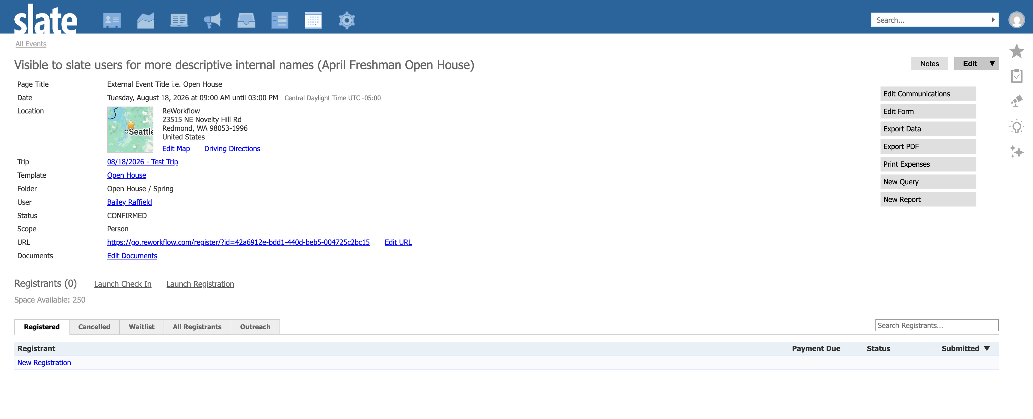
Event Check-In
VISUAL REFERENCE
[ Add Screenshot Here ]

Slide 39




Check-In Methods
EVENT CHECK-IN
Slate supports several ways to record event attendance — pick the right one for your context.
Mobile Wallet Pass
Manual Check-In (Slate)
Registrants receive an Apple/Google Wallet pass. Staff scan it at the door with the slate app. Fast, convenient, and looks polished.
Staff log in to Slate and mark registrants attended from the event check-in page. Simple and works anywhere with internet access.
Virtual Event Check-in
Self Check-in/Geo Check-in
Logs records as attended when they click the connect to event link for slate hosted webinars
Send event communication prior to event with a mobile check in link. Once the attendee arrives to the event and are within 2 kilometers (about 1.25 miles) of the event they will be able to check in themselves.

Slide 40
Check-In Best Practices
EVENT CHECK-IN
01
Test your check-in method before event day
Scan a mobile pass or load the check-in list in advance. Don't discover issues at the door with 200 people waiting.
02
Use Attendance Override for edge cases
If someone attended but wasn't checked in properly, use the override field on the registration record — no need to reverse engineer the check-in flow.
03
Train your staff on the method you're using
Check-in fails most often because staff use the wrong tool or don't know where to find the check-in list in Slate.
04
Post-event: verify your attendance data quickly
Run a quick count of attended vs. registered in Slate before closing out the event. Catch discrepancies while the event is still fresh.
05
Tie check-in to downstream workflows
Use attendance data to trigger follow-up communications, update funnel stages, or feed reporting dashboards — don't let it sit idle.

Slide 41
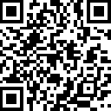
Questions? Contact Us!
Useful Knowledge Base Resources
knowledge.technolutions.net/docs/events-overview
knowledge.technolutions.net/docs/event-templates
knowledge.technolutions.net/docs/event-registration-forms
knowledge.technolutions.net/docs/event-communications-overview
knowledge.technolutions.net/docs/event-invitations-and-rsvp
Slate Events Unlocked | STAG

